Slide 1

Day 10
The Spirit Is
UNLEASHED
On Earth
DAYS OF
PRAYER
January 7-17, 2026
Notes:
Welcome to Day 10!
Today we’ll see how Luca’s story comes full circle.
The Spirit that worked in heaven is now working on Earth.

Slide 2
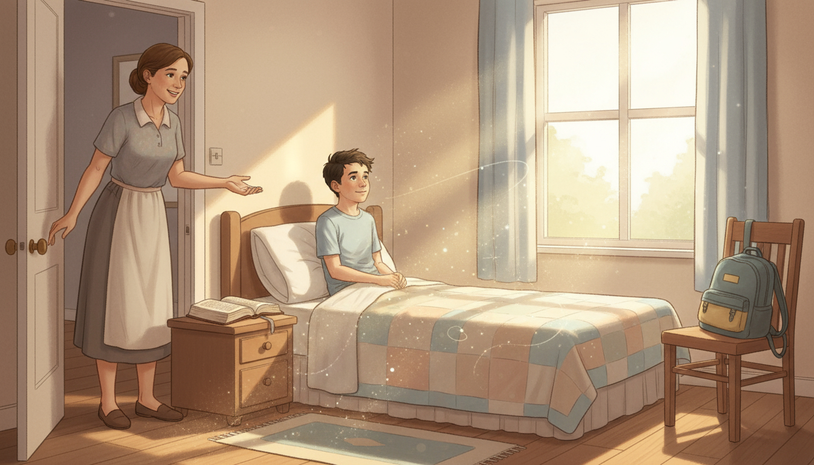
Notes:
“Luca! I’ve been calling you for ten minutes,” Mom says.
Luca slowly opens his eyes. “Where am I?”
“You’re home, son! You’ll be late for school!”
“Mom! I was in heaven—I met Bible heroes and saw amazing things!”
Mom laughs. “It must’ve been a special dream.”
“A dream that felt more real than anything!” Luca says softly.

Slide 3
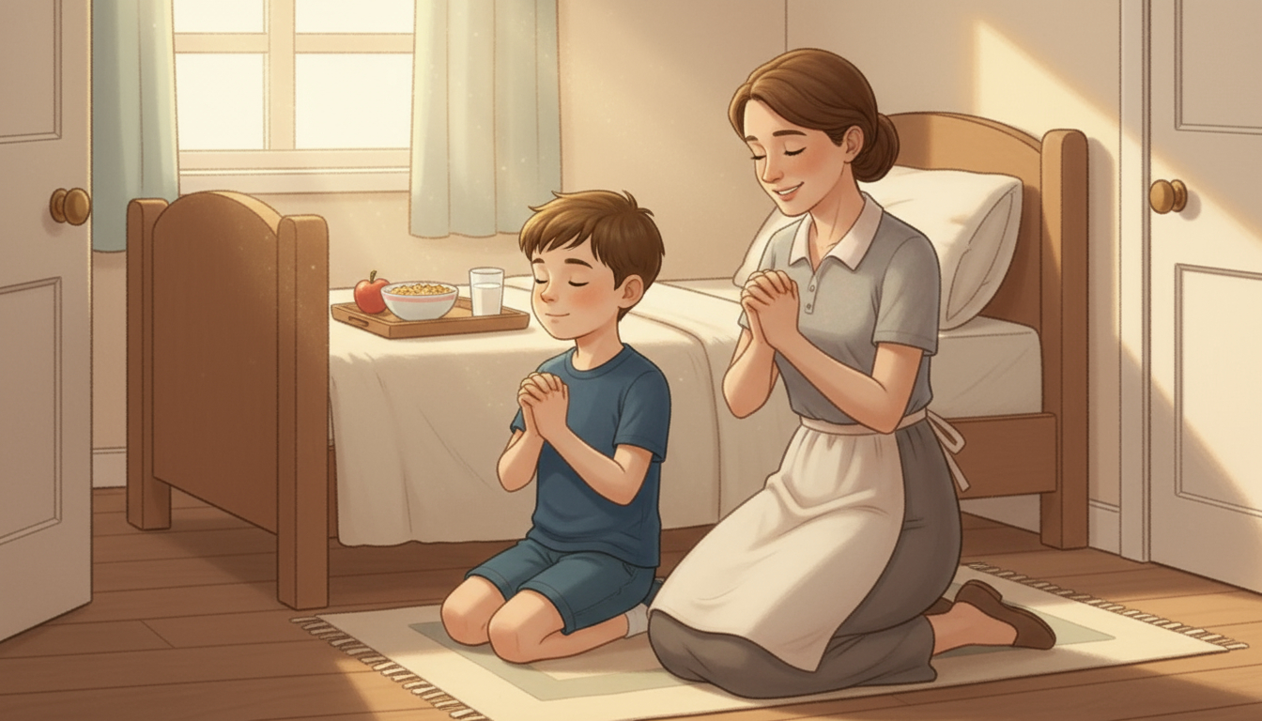
Notes:
Luca gets dressed and smells breakfast on the table.
“Everything feels different, Mom. Like heaven is close!”
“That’s because the Holy Spirit is near us every day,” she says.
“Let’s pray before you go,” Mom adds, taking his hands.
Together they kneel and pray, thanking God for the new day.
“Thank You, Lord, for being with us and filling us with Your Spirit,” says Mom.
“Amen,” whispers Luca, smiling.

Slide 4
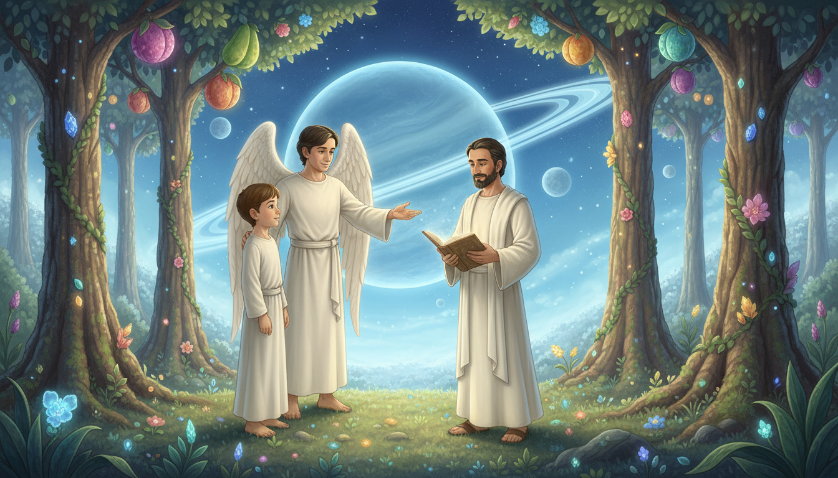
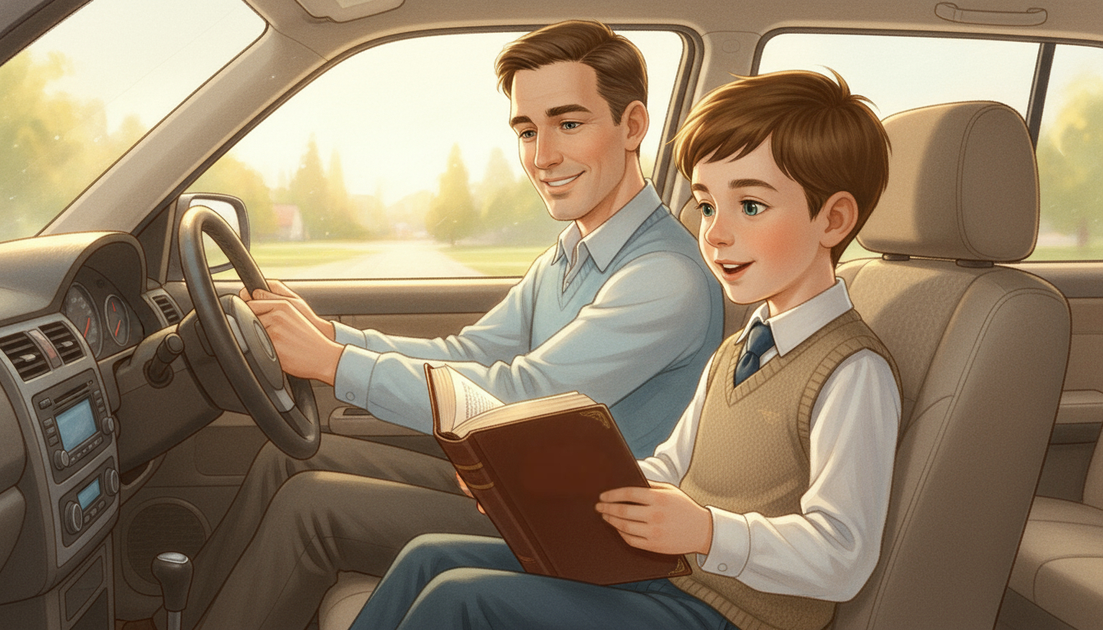
Notes:
Luca hops into the car. “Dad, who would you like to meet in heaven?”
“Oh, many—Moses, David, Paul…”
“I already met them!” says Luca excitedly.
Dad laughs. “Then you’ve seen what God is preparing for us!”
“But remember,” he adds, “we must be faithful and do our part.”
“Are you carrying your Bible?” asks Dad.
“Yes!” says Luca. “What should I read?”
“Open it to Acts 1:8.”
Luca reads:
“But you will receive power when the Holy Spirit comes on you; and you will be my witnesses… to the ends of the earth.”
Dad nods. “To go to heaven, we must receive the Spirit and fulfill the mission.”
“The Spirit must be unleashed in our lives!”

Slide 5
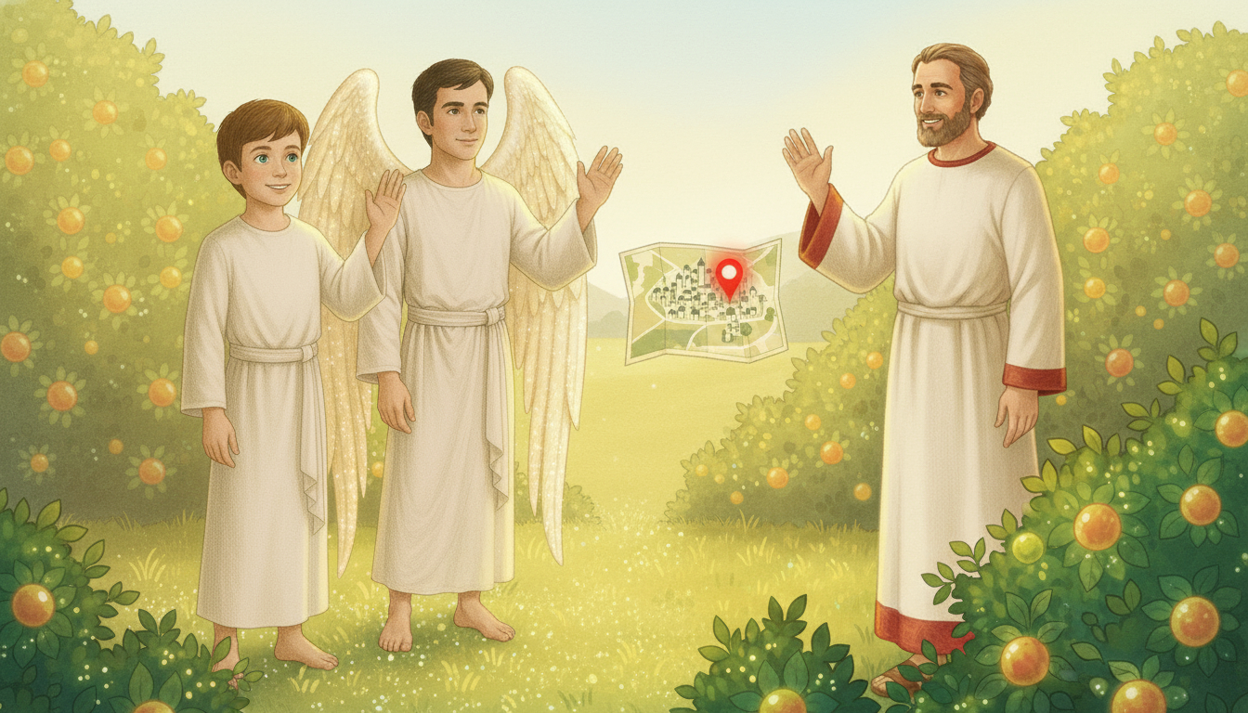
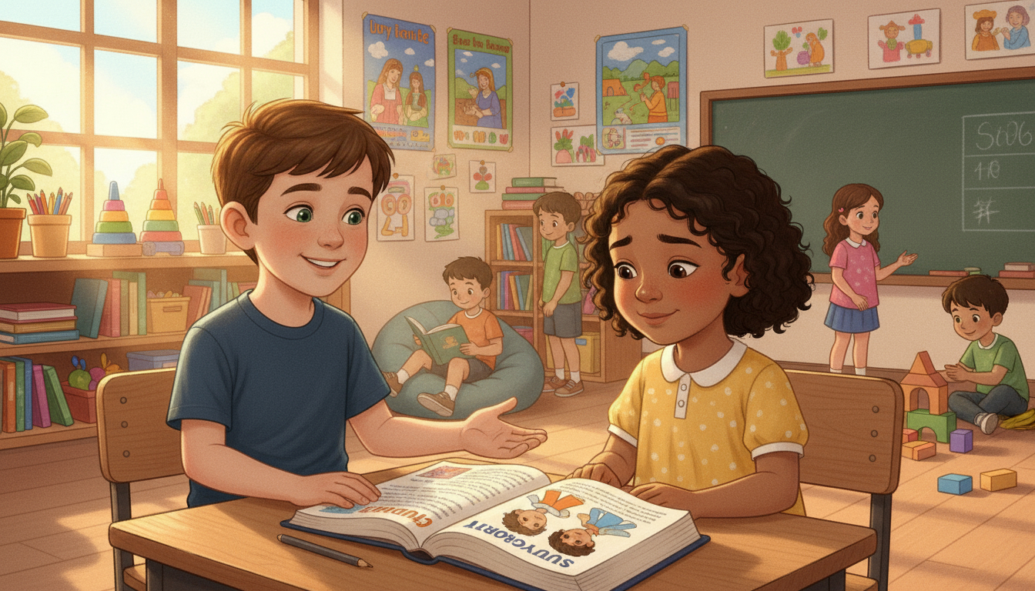
Notes:
Luca takes his seat near the front.
A girl sits beside him. “Hi, I’m Amanda,” she says shyly.
“Hi! I’m Luca,” he replies. “Would you like to study the Bible with me and my friends?”
“Yes,” she answers with a smile.
Luca grins—his first Bible student! He whispers, “Thank You, Holy Spirit.”

Slide 6
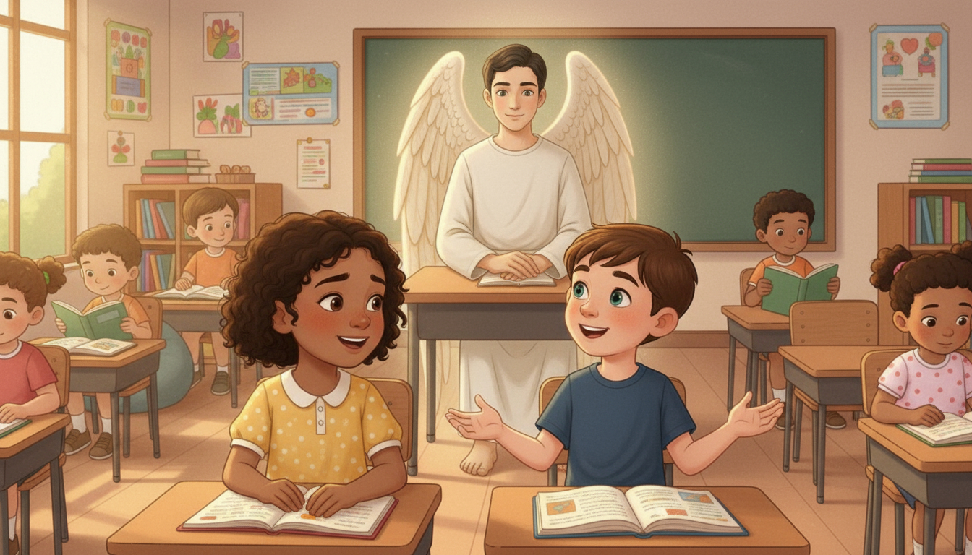
Notes:
From an empty desk at the back, Orel watches quietly.
He smiles, thinking: “You will be great in the Lord, dear Luca.”
“Just a little longer, and we will meet again to live incredible things in heaven with Jesus.”
The Spirit is unleashed—right here, in Luca’s everyday life.

Slide 7

Notes:
The Spirit was unleashed on Earth—and in Luca’s life.
Let’s Get to Work!
Make a list of five friends who don’t know Jesus.
Pray for them and invite them to study the Bible.
With your family’s help, organize a small Bible class.
Let’s Pray!
Ask the Spirit to be unleashed in your life.
Pray that He helps you bring others to Jesus.

