Slide 1

PRESIDENTIAL INITIATIVE
Mission-Centric Leadership

Slide 2

MISSION REFOCUSING!

Slide 3


Slide 4


Slide 5
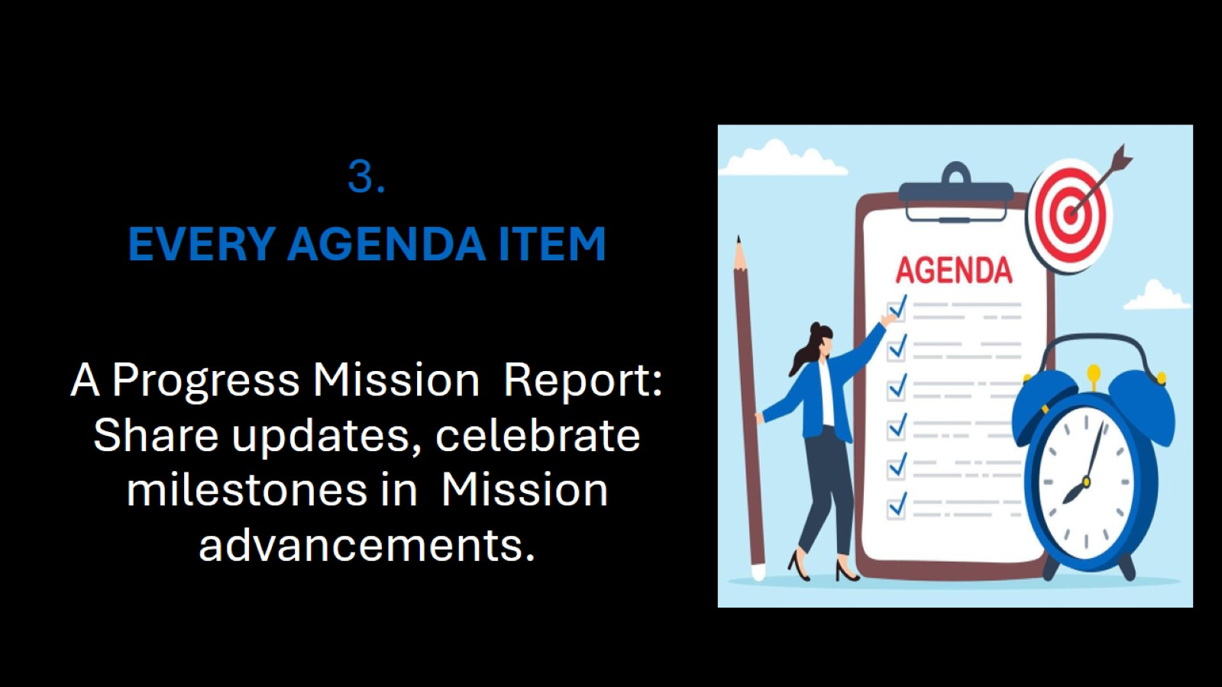

Slide 6
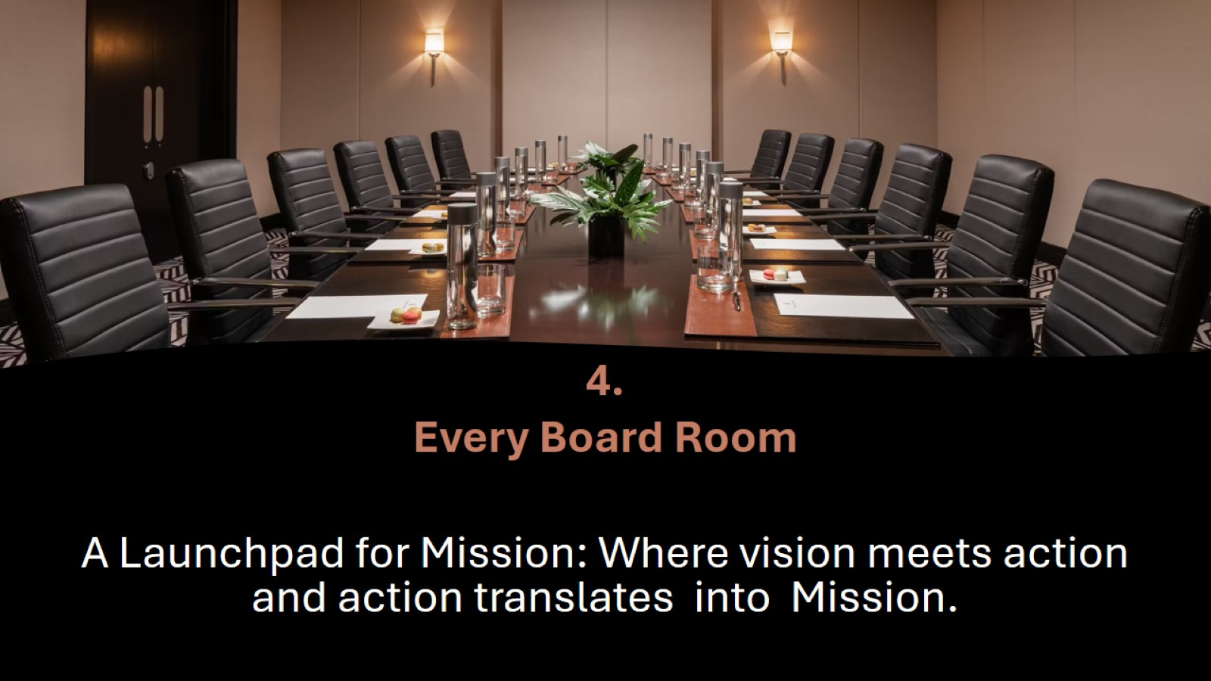

Slide 7


Slide 8

What
WAD needs now

Slide 9
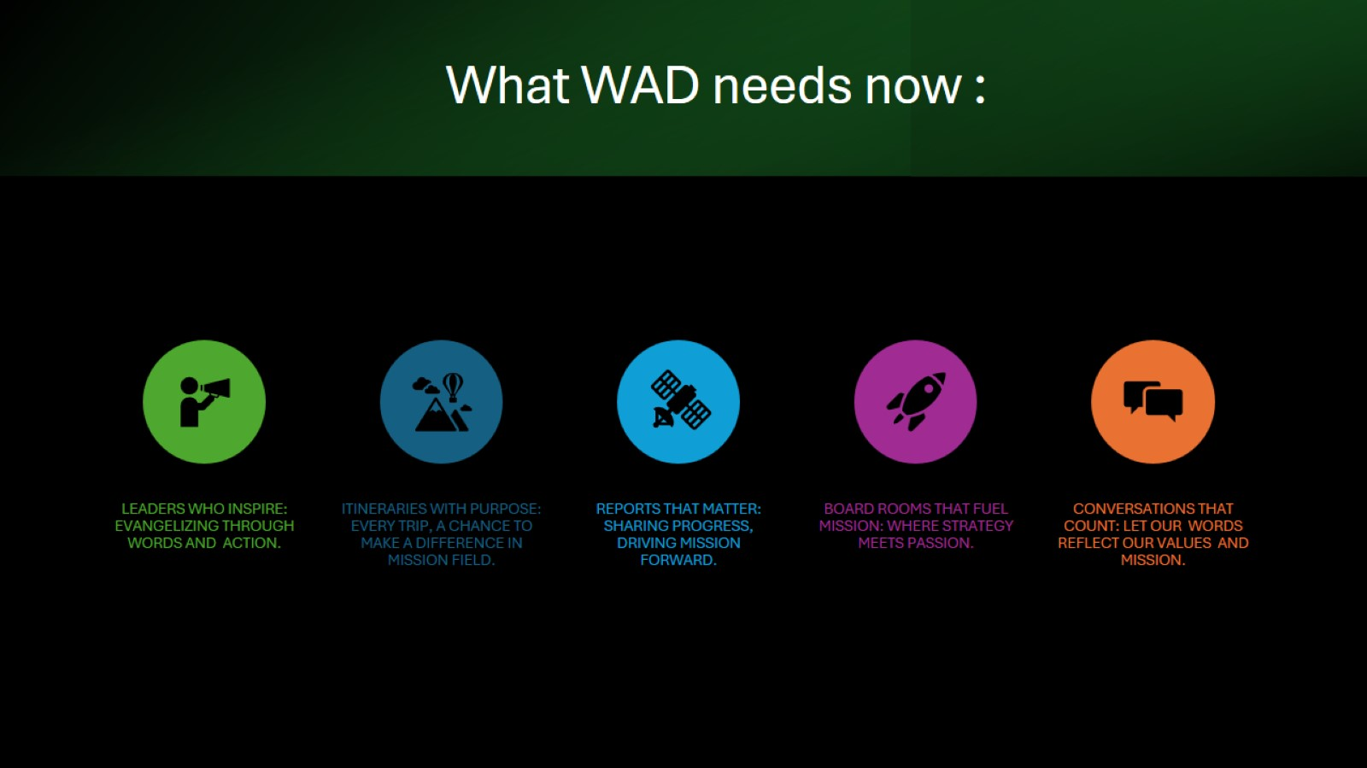
What WAD needs now :

Slide 10

What WAD needs now :

Slide 11

What WAD needs now :

Slide 12
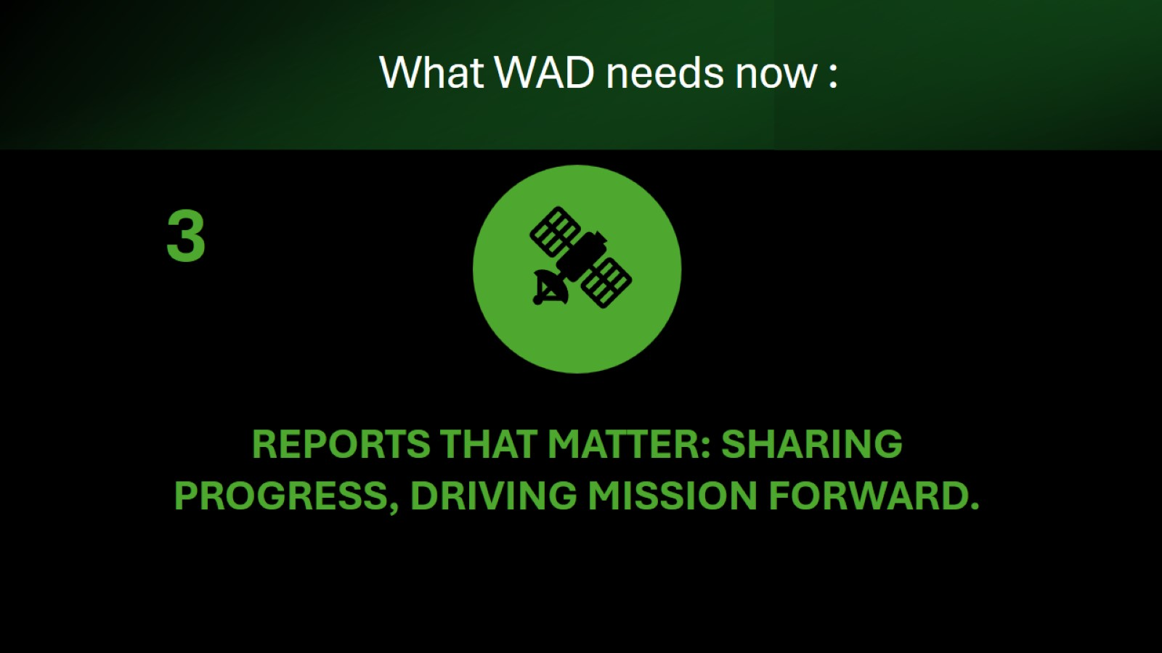
What WAD needs now :

Slide 13
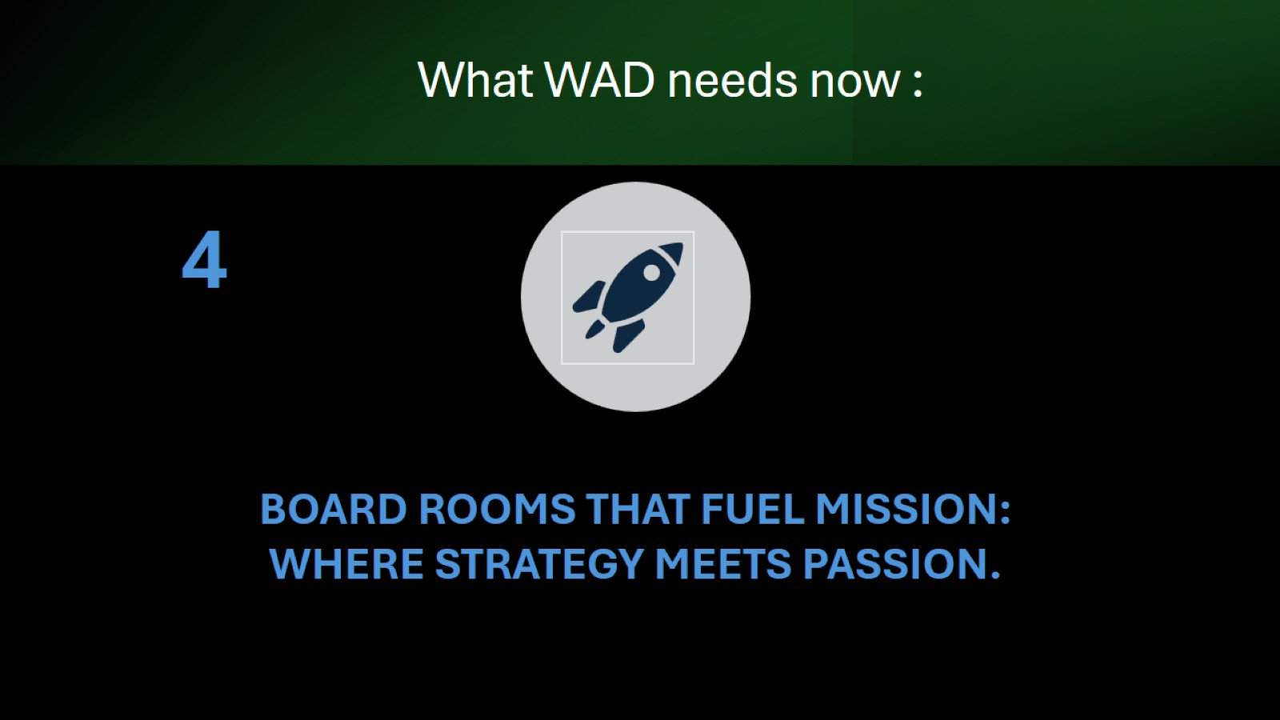
What WAD needs now :

Slide 14
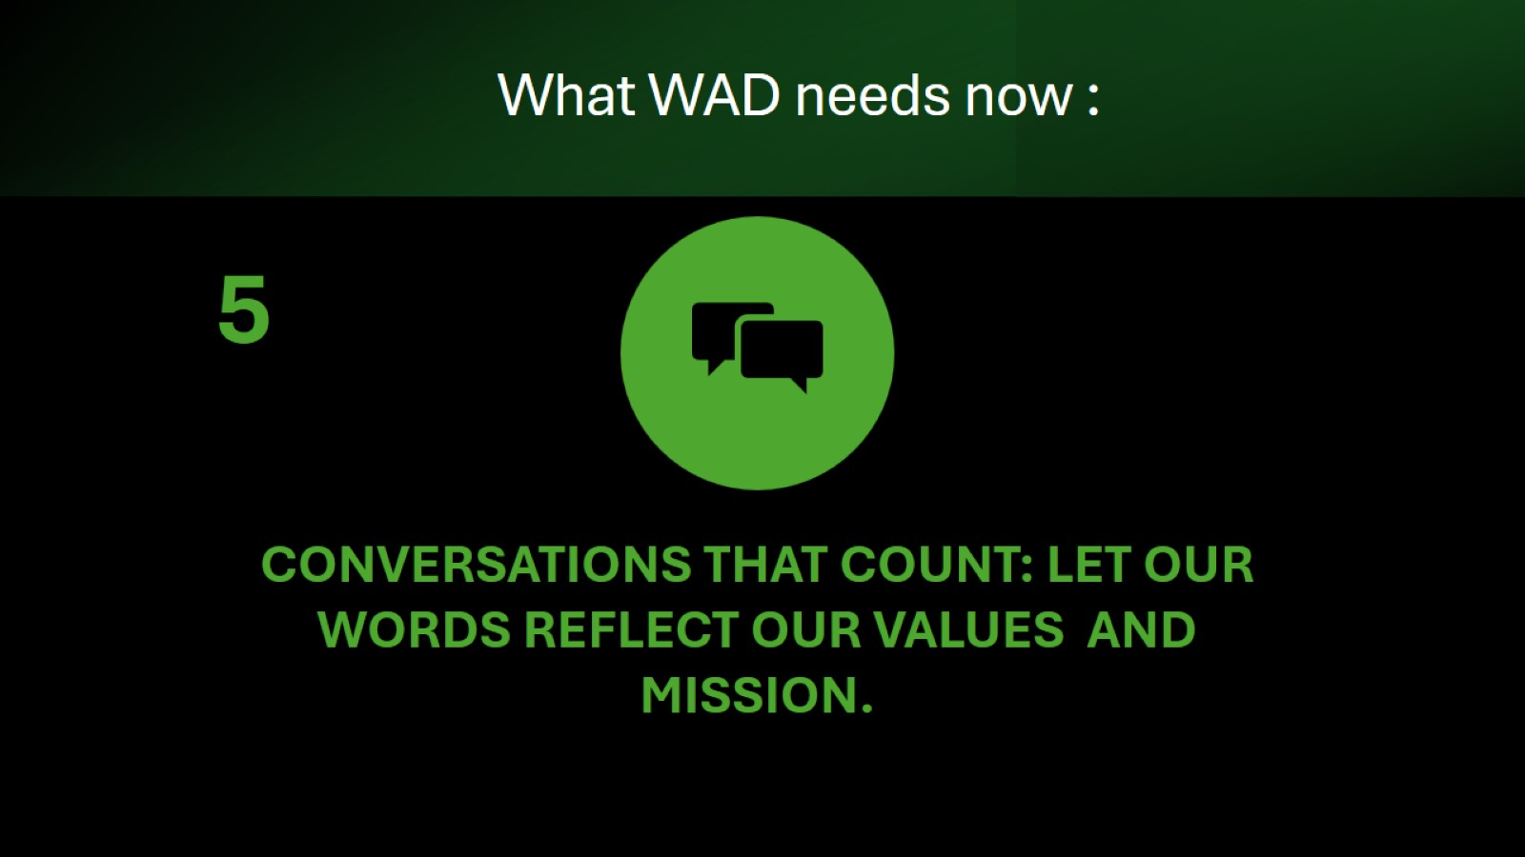
What WAD needs now :

Slide 15
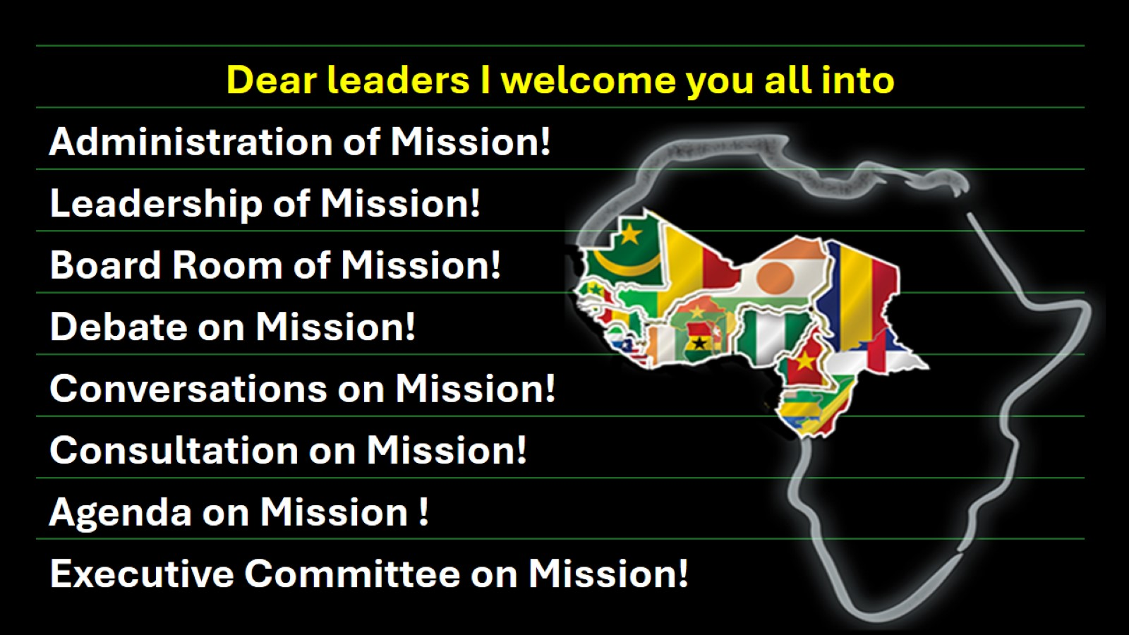

Slide 16

Y O U
A R E
W E L C O M E

Slide 17
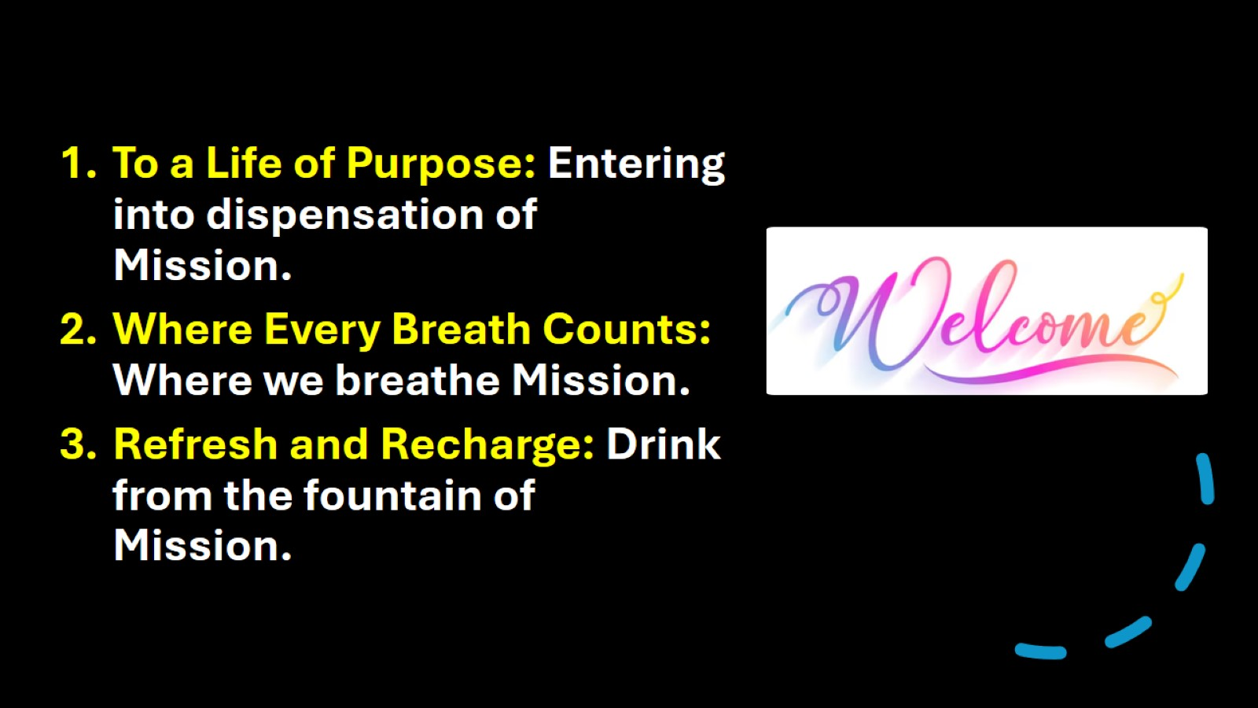

Slide 18
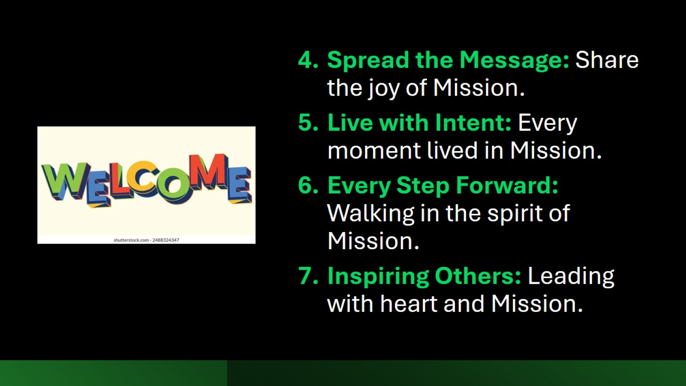

Slide 19
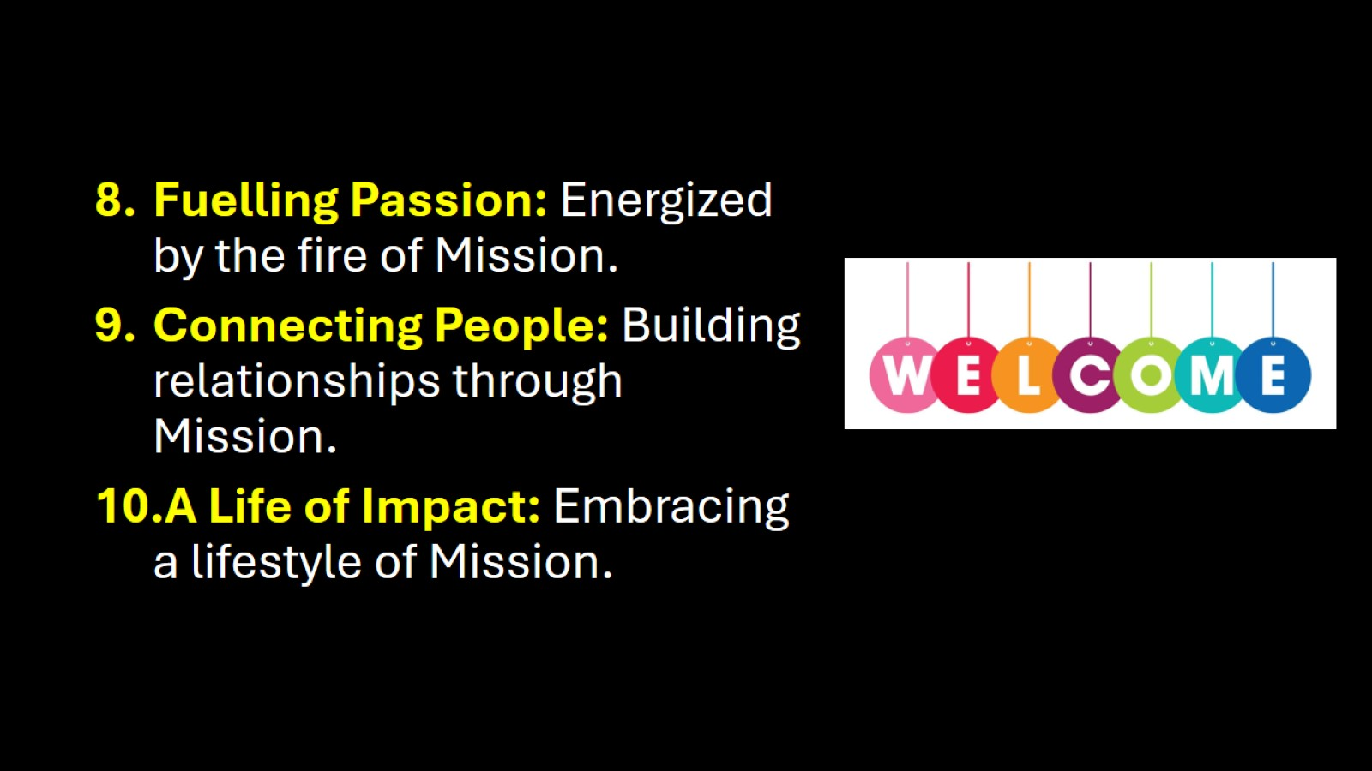

Slide 20

Y O U
A R E
W E L C O M E

Slide 21
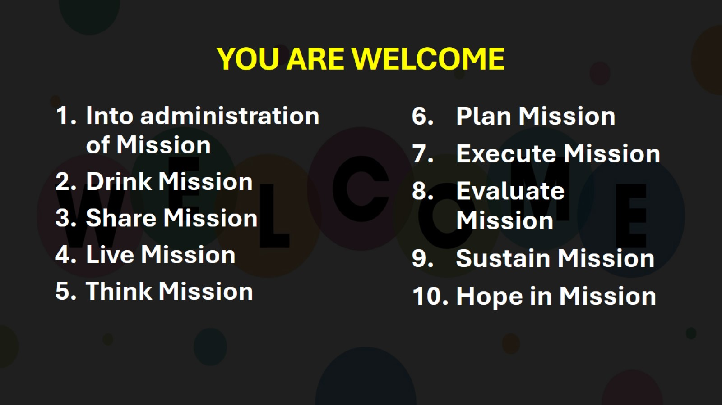
YOU ARE WELCOME

Slide 22


Slide 23
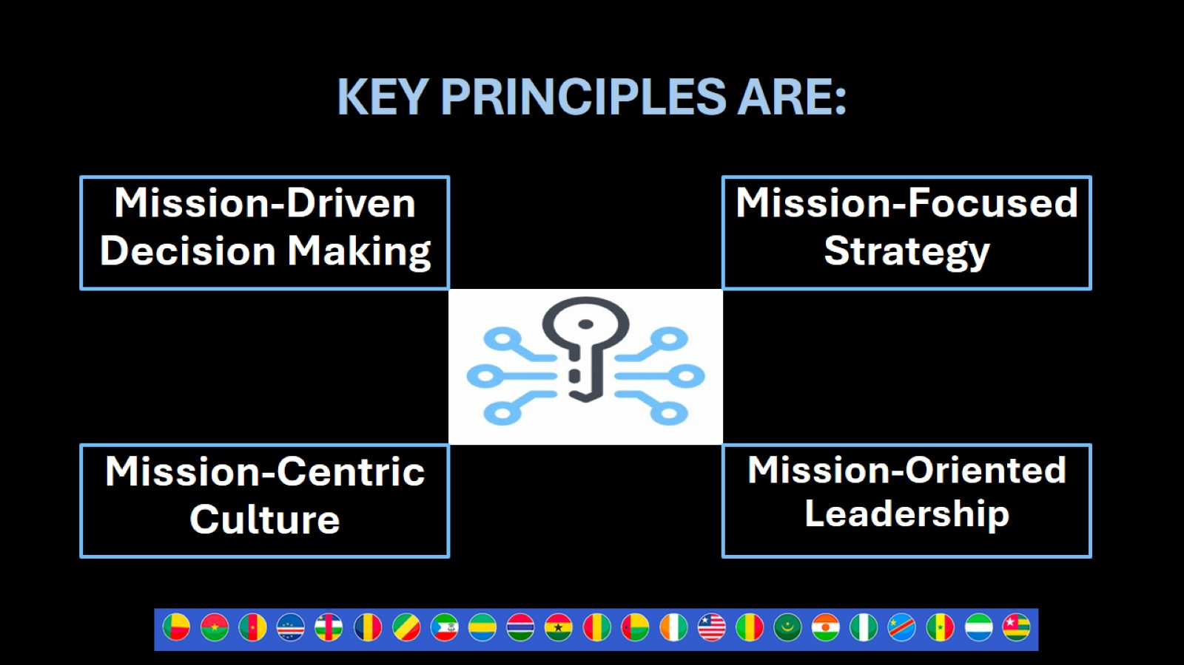
KEY PRINCIPLES ARE:

Slide 24
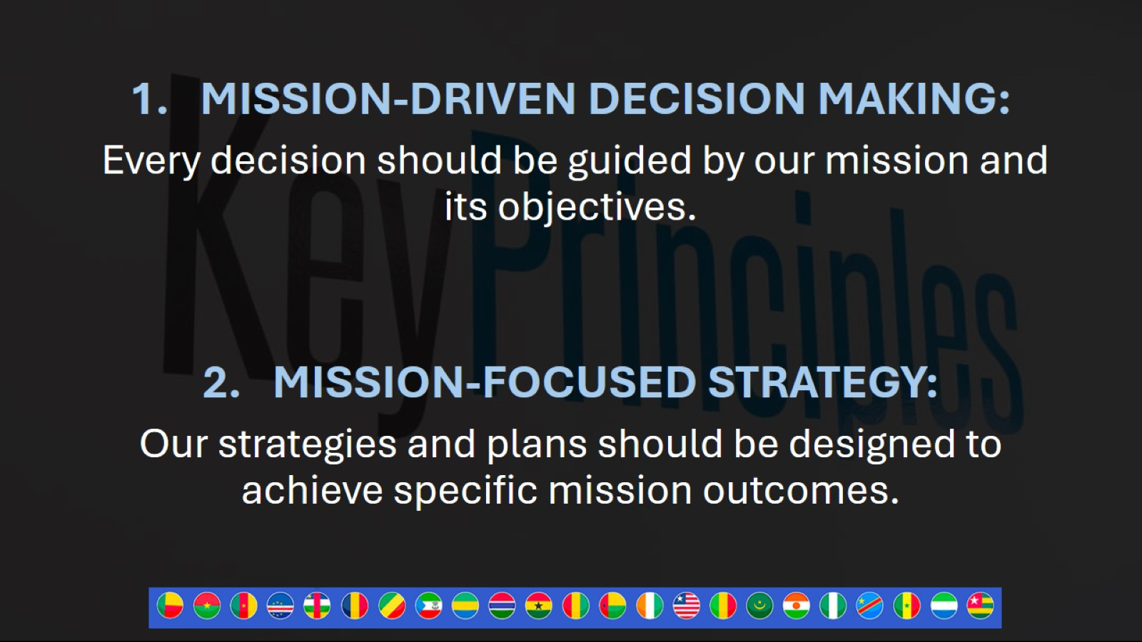

Slide 25
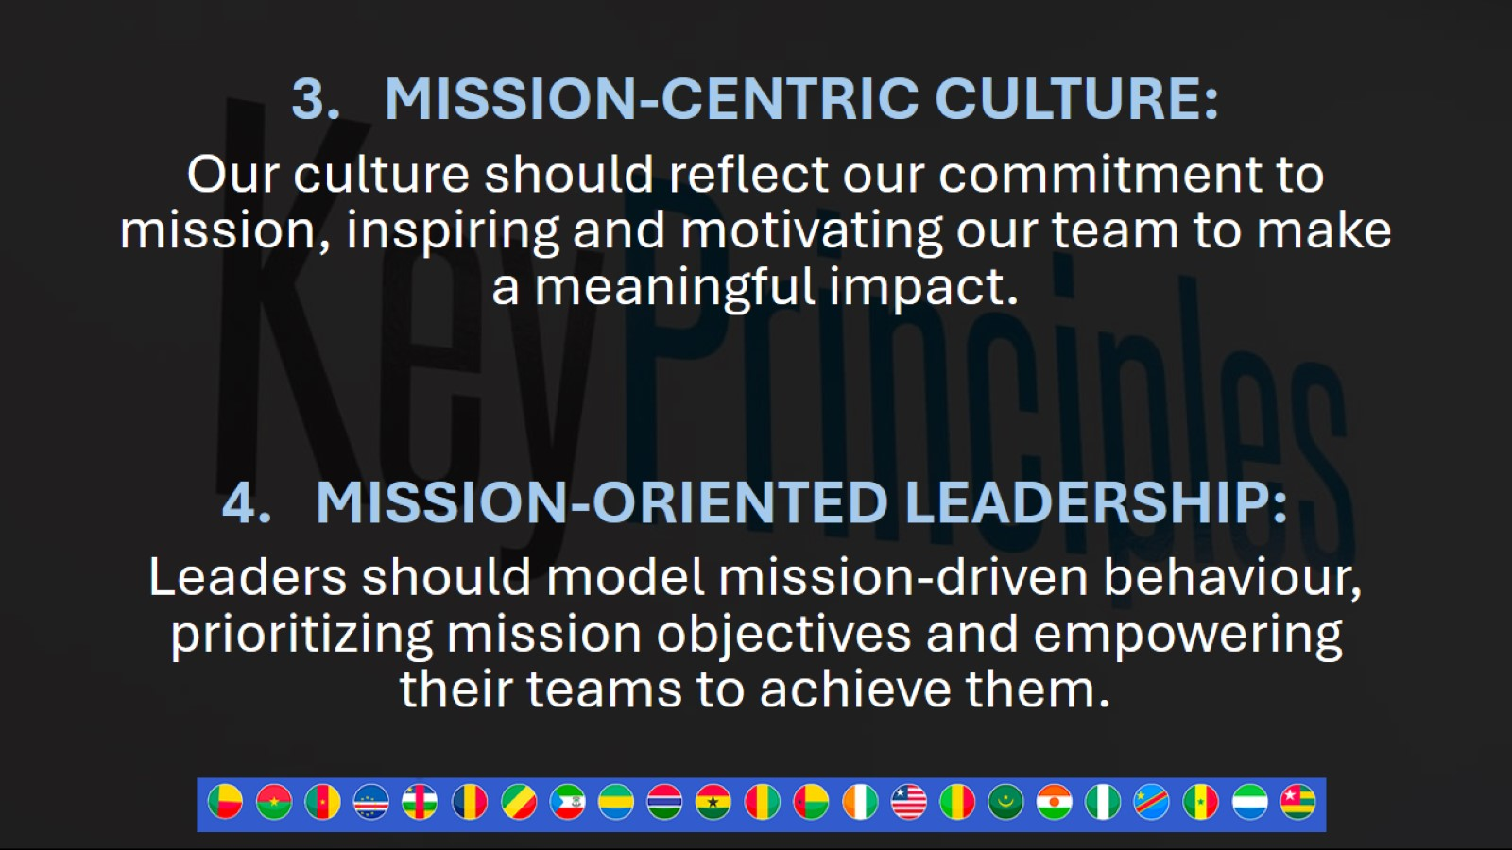

Slide 26

OUR
BUSINESS
IS
MISSION

Slide 27
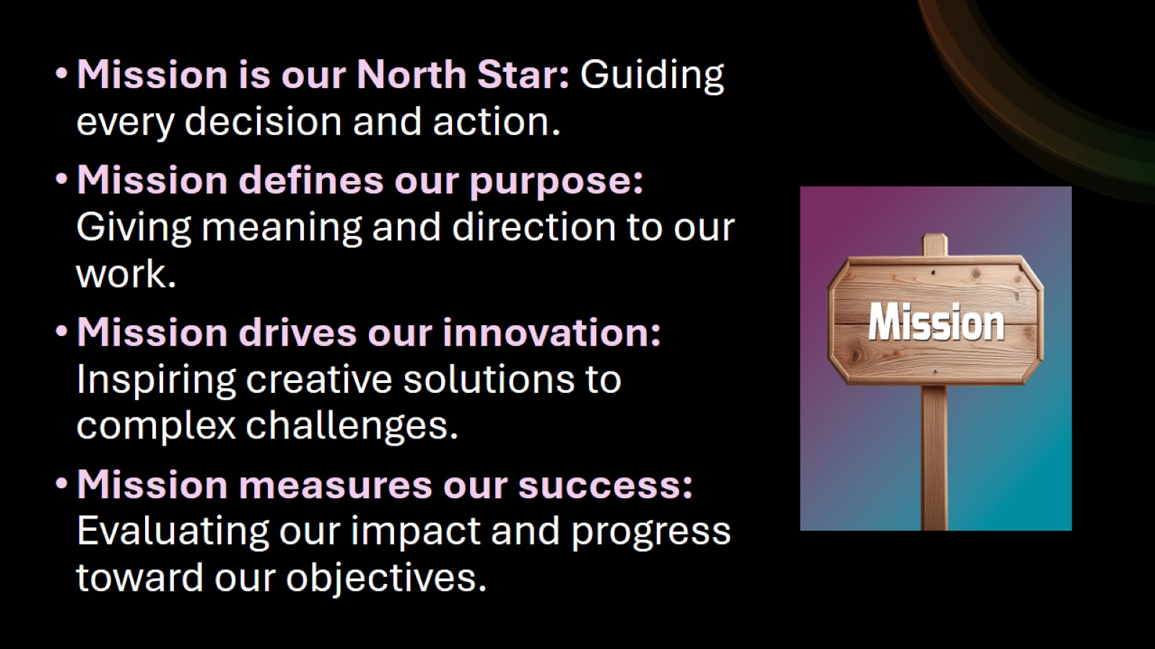

Slide 28
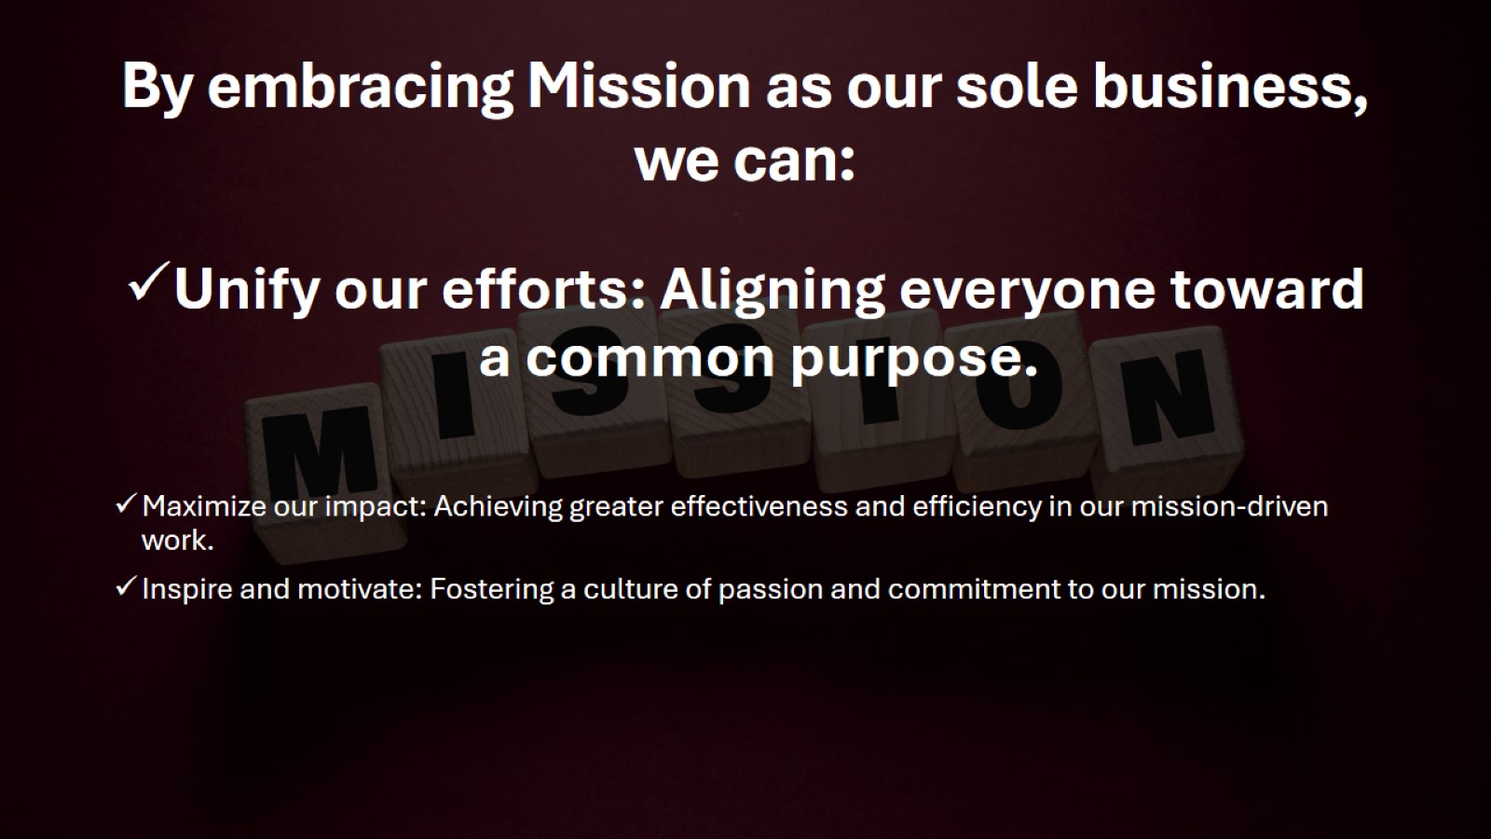
By embracing Mission as our sole business, we can:

Slide 29
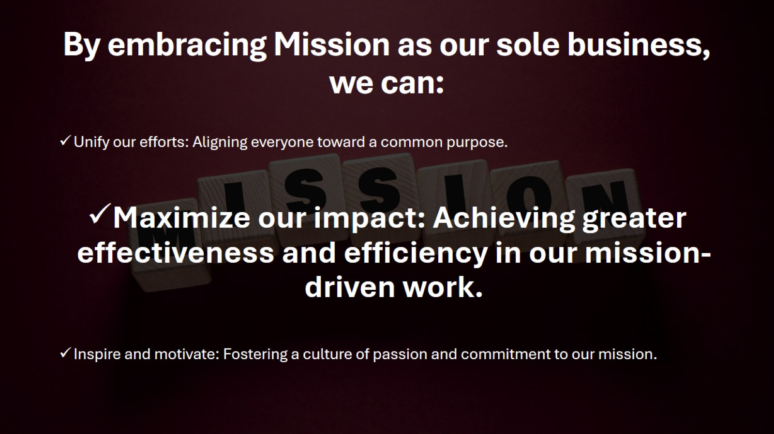
By embracing Mission as our sole business, we can:

Slide 30
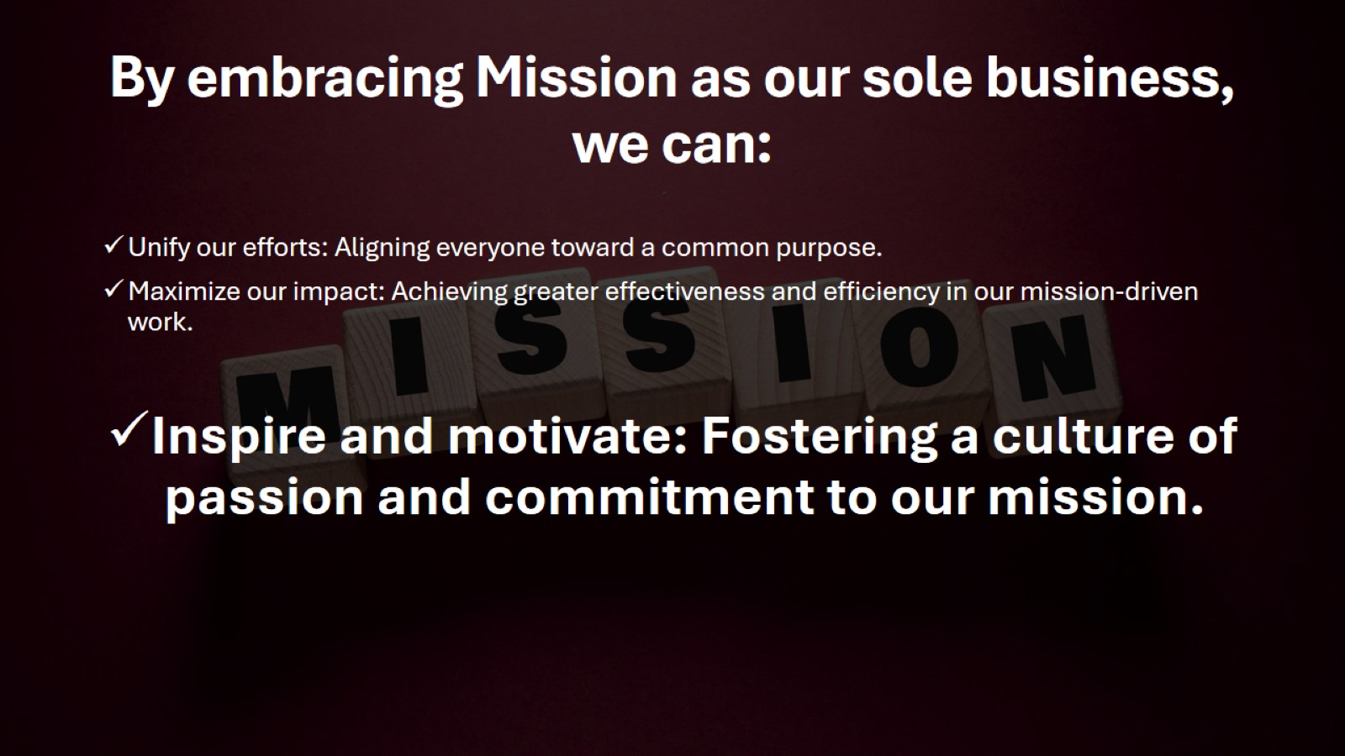
By embracing Mission as our sole business, we can:

Slide 31
