Slide 1
YOUR ROLE AS A BELIEVER
By Juvénal Balisasa, PhD

Slide 2
Evaluation:
The topic that touched/helped you the most
The topic that was most difficult
What you wish could be improved
What expectation was not fulfilled

Slide 3
“How then shall they call on him in whom they have not believed? and how shall they believe in him of whom they have not heard? and how shall they hear without a preacher? And how shall they preach, except they be sent? as it is written, How beautiful are the feet of them that preach the gospel of peace and bring glad tidings of good things!”
ROM. 10: 14-15

Slide 4
Let the Truth Set You Free
Understand the End-Time Dynamics & Prepare to Minister
Make up your Mind to Be Profitable in God’s Vineyard
Know your Vulnerability and Cling to the Source of your Strength
Apply the NICODEMUS principle
Go, Conquer Through God’s Word
—1
—2
—3
—4
—5
—6

Slide 5
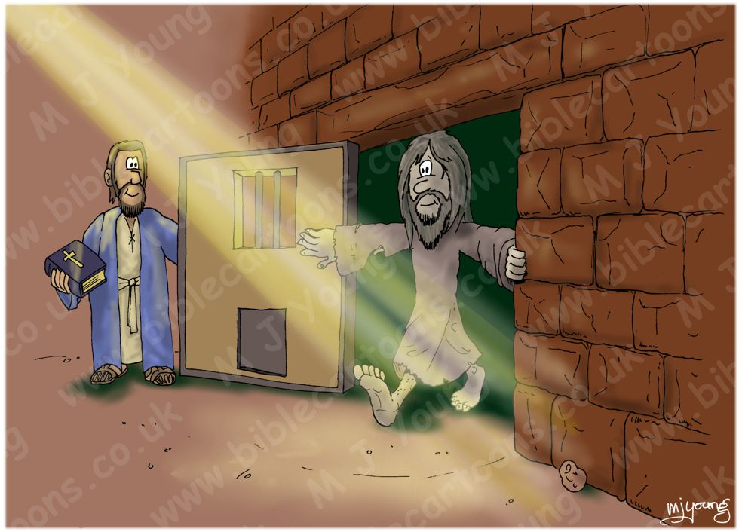
1.
“And ye shall know the truth, and the truth shall sent you free.”
JOHN 8: 32

Slide 6
The meaningfulness and profitability of our life and living depends indispensably of our conception, representation, interpretation, and application of the truth.
WRONG
Right
__conception, __representation, __interpretation, __application
of truth.
Meaninglessness of life and living
Meaningfulness of life and living
ARE YOU REALLY BEING FREED BY THE TRUTH?

Slide 7
Jesus’ Bitterest Teaching Experience
Thomas said to him, “Lord, we don’t know where you are going, so how can we know the way?” Jesus answered, “I am the way and the truth and the life. No one comes to the Father except through me. If you really know me, you will know my Father as well. From now on, you do know him and have seen him.” Philip said, “Lord, show us the Father and that will be enough for us.”
^{JOHN 14: 5-8}
Notes:
The length of bachelor’s degree in Theology in WAD is three to four years
In the virtual university of Judea, department of ministerial and theological education, the length of the degree was three and half years. The curriculum hinged on communicating the truth as it relates to three main domains namely preaching, prophecy, theology, pedagogy, andragogy, healing, field work, role modeling, and disciple making. In the final semester the end of the program, the teacher is confronted with a chocking discovery about how much truth the future truth communicators know. The teacher attempt at clarifying the truth he had so far taught his students, only to discover that the students had gotten wrong perceptions and wrong interpretation, wrong application and wrong of the truth.

Slide 8
TRUTH WILL ALWAYS REMAIN MEANINGLESS AND INEFFECTUAL AS LONG AS IT IS SEPARATED FROM THE WAY, AND THE LIFE
THE WAY: Process—Livelihood– see Ps. 119:
THE TRUTH: Activities: Thoughts, Words, Actions—Phil. 2: 5; Matt. 11: 29
THE LIFE: Output/End result—Lifestyle—Destiny

Slide 9
Jesus’ perception of truth:
Jesus’ representation of truth:
Jesus’ interpretation of truth:
Jesus’ application of truth:
How much truth do we know?
What is our percetion of it?
What is our representation of it?
What is our interpretation of it?
What is our application of it?

Slide 10
Jesus’ perception of truth:
John 17: 17
“Sanctify them by Your truth. Your word is truth.”
MATT. 17: 17
“For verily I say unto you, Till heaven and earth pass, one jot or one tittle shall in no wise pass from the law, till all be fulfilled.”

Slide 11
Jesus’ representation of truth:

Slide 12
JESUS’ INTERPRETATION OF TRUTH:
“Thus says the Lord…”
MATT. 4: 1-11

Slide 13
Jesus’ application of the truth:
JOHN 6: 38
“For I have come down from heaven not to do my will but to do the will of him who sent me.”

Slide 14
Strive to Be
Freed by the Truth

Slide 15
Understand The End-Time Dynamics
2.
The Rest of the Generation
God’s Generation

Slide 16
Spiritual Dynamics In The End-Time Generation
BABYLON CHURCH
REMNANT CHURCH
Returning To Babylon
Coming Out Of Babylon
Satan’s People
God’s people
Satan’s People
God’s People
Witnessing To Babylon
Persecuting God’s Church
Notes:
There are people in the Babylon Church who are sincerely seeking the truth but are being deceived. If they hear the voice and see the fruits, they will leave Babylon.
There are people in the Remnant Church who aware of the truth but are working for Satan in the house of God. When the tribulations come they will leave God’s Church and betray God’s people.

Slide 17
THE COMPLEXITY OF THE TASK
God’s
Generation’s Mission To
The
The Rest of The End-Time Generation
The
Rest Of the End-Time
G
E
N
E
R
A
T
I
O
N
Witness, warn, & welcome
Blindfolded
Scoffing & Ignoring
Persuasion, Apologetics
Enemy’s Agents in the World
Deception & Persecution
Enemy’s Agents in God’s Church
Resist, Refrain, Restore
Deception, Persecution,
Demoralizing, & Betrayal

Slide 18
THE ULTIMATE TASK OF THE 1ST AMGEL’S MESSAGE
God’s
G
E
N
E
R
A
T
I
O
N
The
Rest Of the End-Time G
E
N
E
R
A
T
I
O
N
Romans 10: 14-15
Blindfolded
2 Corinthians 10: 4-5
Enemy’s Agents
in the World
2Timothy 4: 2-43: 1-9
Enemy’s Agents in the Church

Slide 19
Where Is That Generation of Disciplers & Leaders?
The house-to-house Evangelists
The Apologetics
The Persuaders
The people of the Book
The Living Sacrifices
Where is the Day-of-Atonement Attitude?

Slide 20
Where Are Such Leaders?
The role models
The royal priesthood
The selfless ministers
The great expounders of the Word
The stewards of holy ordinances
The caring teachers & professors
The enthusiastic youth leaders
Notes:
Notice that something is gradually going wrong even in the church

Slide 21
How Could There Be Such Disciplers and Leaders—At This Time When The Church & The World Are Being “Nurtured” To Becoming More and More Allergic To Absolute Truth?

Slide 22
How Could There Be Such Disciplers and Leaders– At This Time When Ministers & Church Leaders Are Opting For Pleasing Earthy Settlers Thereby Becoming Mere Demagogues And Soothsayers!

Slide 23
Beware of the Danger and High Risk!

Slide 24
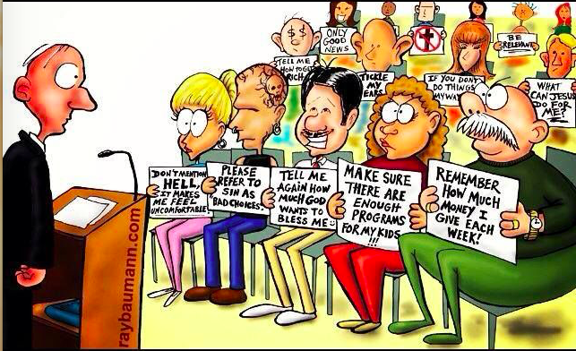
Churches Have Become Mere Self-Centered Social Clubs!

Slide 25
Worldly Philosophy
Wrong Ed. Systems
Erroneous Learning Purpose
Conflict/ Confusion
Hopelessness
Naturalism
Relativism
Egotism
Who Is Right?
Criminality/ Calamity
The Competing Educational Systems
Creation
Divine Truth
Altruism
God Is Right
Hope & Love
Christian Philosophy
Bible-based Systems
Christ-centered Purpose
Bible—the lamp onto our feet
Realities of Eternity

Slide 26
Competence
Concubines
The Focus
The Focus
Commitment
Castles
Divine
Devilish
Conversion
Cars
Call
Certificate
Possible Trajectories of End-Time Learned Christian Adventist Believer

Slide 27
Competence
Concubines
The Focus
The Focus
Commitment
Castles
Divine
Devilish
Conversion
Cars
Call
Certificate
Trajectory of End-Time Christian Education Graduate

Slide 28
3.
STRIVE
TO BE PROFITABLE IN GOD’S VINEYARD

Slide 29
REMEMBER,
Christ needs for His Church and Institutions leaders who will neither be sold nor bought.
[Edu., p. 57]

Slide 30
Christ needs for His Church and Institutions leaders who are not lazy at His Word and Work
[2 TIM. 2: 15]

Slide 31
Christ needs for His Church and Institutions leaders who are exemplary in all facets of life
[1 TIM. 4: 12]

Slide 32
Christ needs for His Church and Institutions leaders who are ready ready to break the status quo, no matter the cost to their peace, position, or promotion.
[Acts 5: 29]

Slide 33
Christ needs for His Church and Institutions leaders living what they preach and preaching what they live
[Rom. 2: 17-24]

Slide 34
Christ needs from AUCA such leaders who are not mere reflectors of other people’s thoughts
[Edu., pp. 17, 18]

Slide 35
Christ needs for His Church and Institutions leaders who are ready to break the stronghold of the Devil.
[2 Cor. 10: 5]

Slide 36
Christ needs for His Church and Institutions leaders who are ready to divorce any self-appointed and “sheep”-meat-addicted, ministerial monarchs whose main business is to brood over snake eggs in the divine end-time poultry farm
[Mark 8: 15]

Slide 37
THIS CALLS FOR NEVER FORGETTING WHO WE ARE

Slide 38
Who are we?
We are God's workmanship,
What are we here for?
created to do good works,
Who decides our work?
which God prepared
When does He decide on our work?
in advance
[Eph 2:10 NIV]

Slide 39
4.
KNOW YOUR VULNERABILITY AND CLING TO THE UNFAILING SOURCE OF STRENGTH

Slide 40
As you set out to play your role as a believer, Never Forget That
Self is weakness (Heb12: 12)
Self is sickness (Isa 1: 5-6)
Self is fear (Isa 41: 14)
Self is blindness (Rev. 3: 17)
Self is ignorance (Prov16: 25)
Self is mob-mindedness (Jer11: 10)
Self is sinfulness (Rom 3: 23)
Self is mortality (1Cor15: 54)
Self is disgrace (Isa 64: 6)
Christ is strength (Phil 4: 13)
Christ is health (Ex. 15: 26)
Christ is love (1 John 4: 16)
Christ is light (John 8: 12)
Christ is omniscience (1Cor1: 25)
Christ is the way John 14: 6)
Christ is holiness (Matt5 : 48)
Christ is immortality (Isa 40: 28)
Christ is grace (2Cor 12: 9)

Slide 41
5.
Never
Idolizing
Corruption
Or
Demagogy;
Eradicating
Mediocrity;
Unshakably
Standing
APPLY THE N.I.C.O.D.E.M.U.S. PRINCIPLE

Slide 42
GO
6.
&
C
ONQUER THROUGH THE WORD OF GOD!

Slide 43
May be the Enemy of wholistic freedom Keeps Rightly Pointing At Your Daily Life, Saying:
__You were conceived in sin (Ps 51: 5)
__Your Life is like a fleeting shadow (Ps. 144: 3-4)
__Your acquaintances will keep betraying you (Ps 55: 12-14)
__Sin dwells in you and therefore evildoing
will always be your lot (Rom. 7: 17)
__You Sin is crouching at your door (Gen. 4:7)
__You are living under a curse (Mal. 3: 9)
__Hard-pressed on every side
__Perplexed
__Persecuted
__Struck down
(2Cor 4: 8, 9)

Slide 44
When the Devil Constantly Remind you
That
Respond to him Saying:
__You were conceived in sin (Ps 51: 5)
__Your Life is like a fleeting shadow (Ps.144: 3-4)
__Your acquaintances will keep betraying you (Ps 55: 12-14)
__Sin dwells in you and therefore evildoing will always be your lot (Romans 7: 17)
__Sin is crouching at your door (Gen. 4:7)
__You are living under a curse (Mal. 3: 9)
__Hard-pressed on every side (2 Cor. 4: 8-9)
__Perplexed
__Persecuted
__Struck down
__In Christ I am a new creature (2Cor 5: 17)
__My mortal will soon put on immortality (1Cor 15: 53, 54)
__Even if my mother and father forsake me, God will pick me up (Ps 27: 10)
__I have been crucified with Christ and it’s longer I who live but Christ who lives in me (Gal 2: 20)
__I will resist the devil and he will flee from me (James 4: 7)
__No weapon forged against me shall prosper (Isa 54: 17)
__Yet not crushed (2Cor 4: 8, 9)
__But not in despair
__But not forsaken
__But not destroyed

