Slide 1
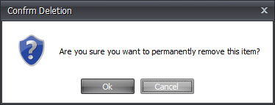
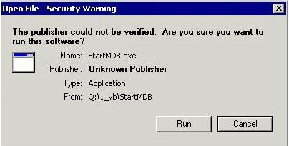
Are you sure you want to be a creationist?

Slide 2
“Creationist:” Google Dictionary
Notes:
It is a privilege for me to be invited to share a talk at this congress. You are aware, from the name and informational material used to advertise the event, that this is a “creationist” congress. “Creationist” is a word that comes with some pejorative connotations attached. In the perception of the public and in academia “creationist” is almost a bad tag. So, I wondered if you and I really want to be associated with such negative perception. Maybe we should not be using this term, if people misunderstand what it means. So, in this talk, I am trying to explore what it means to be a creationist, and what are the aspects of this term that people think are “bad.” Let’s start with Google! Actually, I quite like this definition. First of all, it does not carry negative baggage, it’s descriptive. Secondly, it’s accurate, it reflects well the essence of what it means to be a creationist. So, yes, according to Google’s definition I definitely want to be known as a creationist! What is it then that is generally construed as negative about creationism, and how should we respond to that?

Slide 3
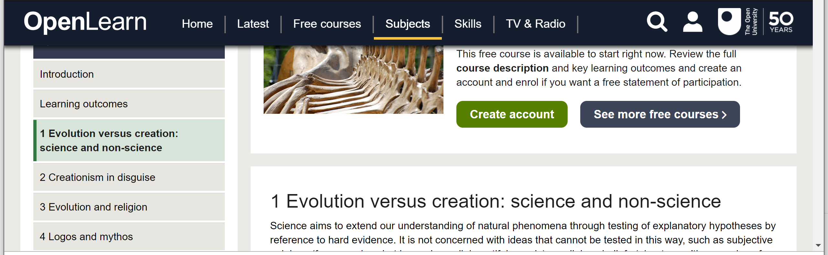
Bad Rep: 1) Creationism is not Science
https://www.open.edu/openlearn/nature-environment/natural-history/the-science-evolution/content-section-1
Notes:
Let’s start with what is typically considered the capital sin of creationism. This free class offered by the Open University instructs us about the fact that creationism is not science. This unforgivable sin can find its way in deceptive reincarnations, like ID, which is called in chapter 2 of the course “Creationism in Disguise”.

Slide 4
Bad Rep: 1) Creationism is not Science
“Creationism, creation “science,” and intelligent design emerged from religious thought, and because they invoke supernatural phenomena, they cannot frame hypotheses that can be tested. Hence, all forms of creationism are not science.”
https://www.geosociety.org/documents/gsa/positions/pos1_TeachingEvolution.pdf
Notes:
The GSA (of which I am a member) has this position statement that specifies why creationism is not science:

Slide 5
Bad Rep: 1) Creationism is not Science
“Much of the development of modern theology of a more liberal sort can be seen as an attempt to maintain Christian teaching about God’s involvement in ‘salvation historyʼ without resorting to accounts of supernatural intervention in the natural order.”
Murphey, N. 2007. Introduction. p. xiii, in N. Murphey, R. J. Russell, W. R. Stoeger, eds. Physics and Cosmology. Scientific Perspectives on the Problem of Natural Evil. Notre Dame, IN: University of Notre Dame Press.
Notes:
So strong is this stigma in a science-dominated society, that theologian Nancey Murphy insightfully suggests that… In other words, for theology to have a chance in the modern world all that is miraculous in Scripture, including our view of origins, needs to be excised or spiritualized.

Slide 6
Bad Rep: 1) Creationism is not Science
“Science cannot completely exclude the possibility of supernatural explanation. It is possible – though very unlikely – that our whole world is controlled by elves. But supernatural explanations like these are simply never needed: we manage to understand the natural world just fine using reason and materialism.”
J.A. Coyne, Why Evolution is True. (2009). New York, NY: Penguin Group. pp. 224-225.
“Scientists do not and cannot claim to prove or disprove the existence of God or other major tenets of religious traditions”
https://www.geosociety.org/documents/gsa/positions/pos1_TeachingEvolution.pdf
Notes:
Interestingly, even evolutionary biologist Jerry Coyne, with wittiness and a tint of derisiveness, acknowledges an important point: if creationism is not science the opposite is also true: “science…” Naturalism is a choice, not a scientific necessity.
For Coyne, it’s a methodological choice, a kind of principle of simplicity. The same demarcation argument used for creationism, can be used for evolutionism or naturalism, when they intend to make ontological statements about the non-existence of God or his lack of interaction with the world. Naturalism also is not science. This is also acknowledged in the same GSA position statement that we quoted before. Scratching just a bit below the surface, we realize that this demarcation approach is too simplistic. It dismisses the reality that science as a method for observing, describing, and predicting patterns and phenomena in nature is complexly intertwined with our presuppositions, interests, and questions about the world. Biblical creationism can indeed generate questions that can be and are being explored scientifically.

Slide 7
Bad Rep: 1) Creationism is not Science
If being a creationist means to acknowledge that there is a God who can, through His power, do infinitely more than all we imagine… then yes, I want to be a creationist.
Notes:
One could argue that this is the very definition of God, isn’t it? Why He is God and we are not.

Slide 8
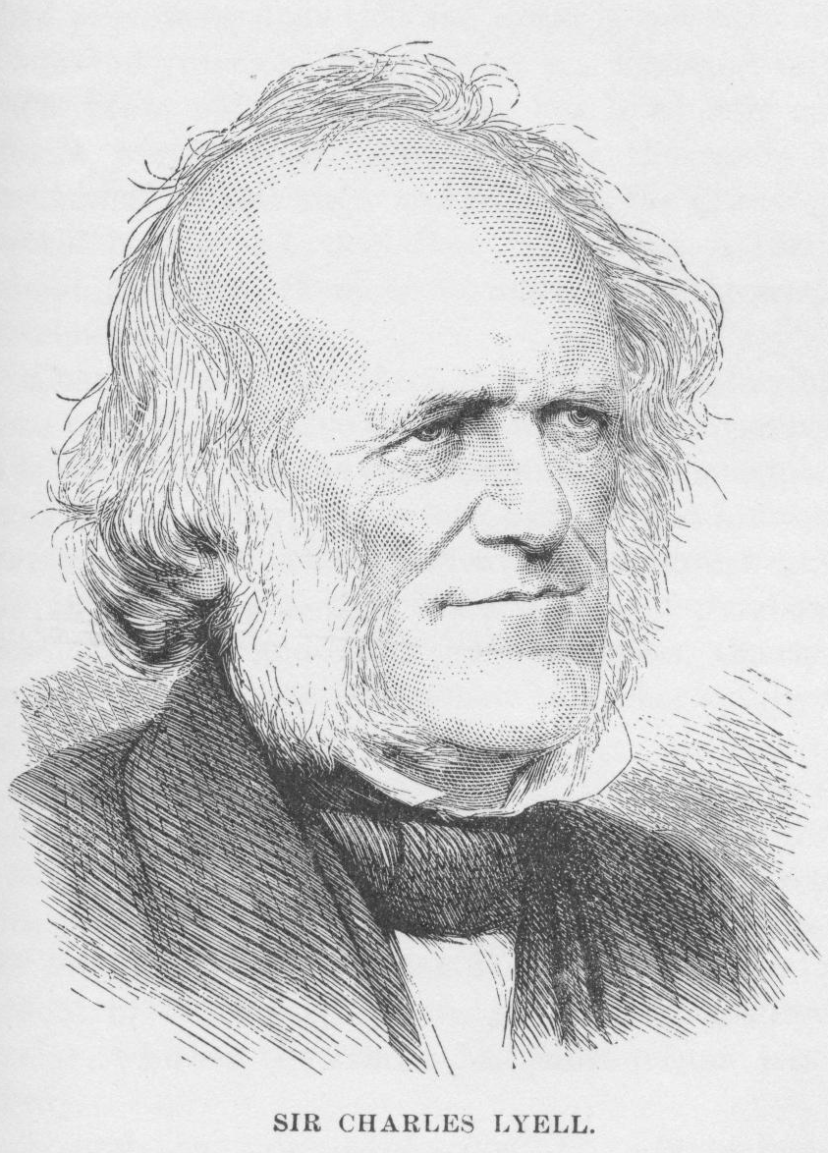
Bad Rep: 2) Creationism is Laziness/Sloppiness
“Never was there a dogma more calculated to foster indolence, and to blunt the keen edge of curiosity, than this assumption of the discordance between the ancient and existing causes of change”.
C. Lyell, Principles of Geology, vol. 1, p. 324
From www.marcdatabase.com
Notes:
The second negative claim about creationism is also somehow connected with the concept of supernatural action. When you accept the possibility of divine intervention, this may become an easy way out to explain away what we don’t understand. In the words of Lyell… This is the so called “God of the gaps” argument. To invoke the supernatural when in reality there is no need of it: with just a bit of work we could find a completely naturalistic explanation.
This approach could even mask a lack of competence, where no careful research is undertaken, but models based on very generic and simplistic knowledge and observations.

Slide 9
God and laws in nature
"God does not annul His laws or work contrary to them, but He is continually using them as His instruments." [Patriarchs and Prophets, p. 114]
“How vast the field in which the Creator can work in harmony with His own laws and yet wholly beyond the comprehension of finite beings!" [PP, p. 114]
Notes:
Let’s reflect a bit more on this argument.
First of all we should be clear that accepting the reality of God does not mean to be against the idea of laws in nature. Theologically we understand that “God…
In fact, the regularities of the world find more meaning (the why of the laws) in accepting the reality of a law-giver and sustainer. And when it comes to understanding the past, it may very well be that the “gaps” are due to our limited comprehension of His laws, not to anomalies or suspensions in their functioning.

Slide 10
God and laws in nature
“While the earth remains, seedtime and harvest, cold and heat, winter and summer, and day and night shall not cease” (Genesis 8:22).
“Assuredly, I say to you, till heaven and earth pass away, one jot or one tittle will by no means pass from the law till all is fulfilled.” (Matthew 5:18).
Notes:
the divine commitment to uphold regularities in the present postdiluvian world is found right after Noah’s exit from the ark. (Gen 8:22) I reflected upon how deep this commitment is by reading a passage where Jesus speaks of another kind of “Law.” (Matt 5:18)
Every detail is important and has a function. This implies we need to be very careful before appealing to anomalies that may be more expression of our ignorance than God’s wisdom.

Slide 11
God and laws in nature
"The Lawgiver is greater than the laws of nature, […] Omnipotence is at no loss for means to accomplish His purposes" (PP 103.3)
"They reasoned, as many reason now, that nature is above the God of nature, and that her laws are so firmly established that God Himself could not change them" (PP 97.1).
Notes:
However, we place these regularities in the context of a world where there exists someone who not only has the power to work through them, but who also is greater than these regularities and established them, marking the seasons of our history and existence. In speaking of the unwarranted assumptions of antediluvians, E. White points out a conceptual flaw “…”

Slide 12
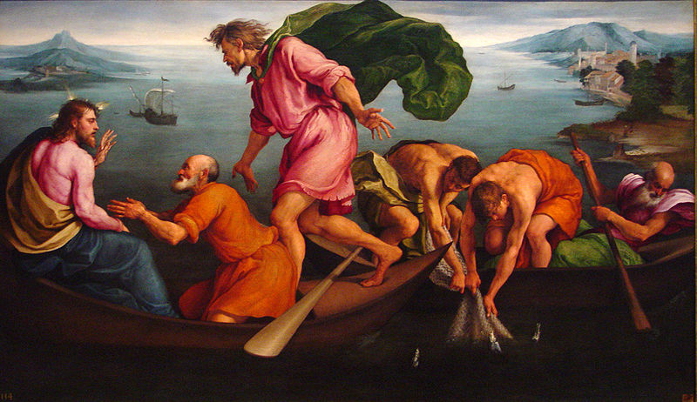
On Miracles and Sloppiness
“Put out into deep water, and let down the nets for a catch.”
Simon answered, “Master, we’ve worked hard all night and haven’t caught anything. But because you say so, I will let down the nets.” (Luke 5:4-5)
Notes:
As for the danger of appealing to miraculous intervention to cover a lack of due diligence and rigorous investigation, I take one biblical episode as my compass to understand what my part is in relation to understanding God’s action in nature. It is Jesus’ command to his disciples to fish in daylight. …
Notice that the creationist approach is not based on a blind and ill-informed effort. It does not dispense with study and hard work. But it is open to listening and acting upon the Word of God. It is a conscious choice, an act of de-centering that acknowledges God’s power transcends our efforts and, when told, we are to go into deep water and cast the nets one more time.

Slide 13
Bad Rep: 2) Creationism is Laziness/Sloppiness
If being a creationist means to respect the process of rigorous observation and the scientific method of hypothesis development and testing, but in a context that is greater than mere naturalism… then yes, I want to be a creationist.

Slide 14
Bad Rep: 3) Creationists are Odd
How different am I?
Notes:
After all this talking about “creationism is not science” you find yourself asking the question “Do I belong or not?” At the end of the day, being a scientist is like being part of a community. There is no baptism but it’s like a church…one of those churches where people look at you and try to size you up… And There is heresy and orthodoxy…

Slide 15
Bad Rep: 3) Creationists are Odd
GSA's Commitment to Diversity
The Geological Society of America (GSA) affirms its belief and commitment to diversity and will continue to develop its diverse base. GSA is dedicated to maintaining an organizational climate where differing ideas, abilities, backgrounds, and needs are fostered with opportunities for members from divergent experiences to participate and contribute. GSA recognizes that diverse perspectives are important and necessary for responsible and representative decision making and leadership. Therefore, GSA strongly encourages the participation in any GSA activity of all its members regardless of race, ethnicity, color, national origin, ancestry, sex, creed, religion, age, genetic information, sexual orientation, gender identity or expression, disability, veteran status, marital status, medical condition, pregnancy, education, class, political affiliation, or parental status, and will undertake reasonable efforts to ensure that its activities are open to all.
https://www.geosociety.org/GSA/About/Diversity/GSA/About/Diversity.aspx#:~:text=GSA's%20Commitment%20to%20Diversity&text=GSA%20is%20dedicated%20to%20maintaining,experiences%20to%20participate%20and%20contribute.
Notes:
We know that there is tension, and it is possible to experience discrimination. But there is also another side to the coin. The scientific community at its best is inclusive: GSA statement on diversity.
We are called to be the salt of the world. Perhaps, this means that we can earn the trust of our colleagues, before debating ideas. We, also, have to learn how to deal properly with what is different: with tact, carefulness, discernment. In the community of scientists we encounter a shared passion, but also different worldviews. Professionally and relationally this can be ground for opposition, but most importantly for opportunity. So…

Slide 16
Bad Rep: 3) Creationists are Odd
If being a creationist means to be original, and have a distinctive voice in a community that shares a passion for the study of the natural world…then yes, I want to be a creationist.

Slide 17
Bad Rep: 4) Creationists have limited answers
Notes:
Science is so attractive because it is essentially positivistic. It promises a progression of enlightenment. A system where all makes sense. A growth with no limit. As a creationist, there are times when I feel more like a wounded Jacob after a night long fight rather than a positivist. I oscillate between this attractive vision, the “clicking,” when everything makes sense, like when I look at impressive evidence for catastrophism in the geologic record, and bouncing against some of the limits of my model of origins. Indeed, as many philosophers of science and scientists themselves understand, science as a whole has limits, and naturalism has big unanswered questions too. But they are usually far removed in singularities and the quantum realm; in the everyday practice most scientists are still positivists. So, what should I think when I feel more like the 12 spies returning from exploration: the land is good, there is great fruit, but also massive fortified cities and giants. Why do these fortified cities exist?

Slide 18
The Necessity
“Divine inspiration asks many questions which the most profound scholar cannot answer. These questions were not asked that we might answer them, but to call our attention to the deep mysteries of God”
Notes:
My first response is that this sense of finitude is actually very healthy

Slide 19
The Necessity
“and to teach us that our wisdom is limited; that in the surroundings of our daily life there are many things beyond the comprehension of finite minds; that the judgment and purposes of God are past finding out. His wisdom is unsearchable.”

Slide 20
The Necessity
“Both in divine revelation and in nature, God has given to men mysteries to command their faith. This must be so. We may be ever searching, ever inquiring, ever learning, and yet there is an infinity beyond.”
Notes:
One must be careful in not twisting this point into an invitation to quit searching, inquiring, and learning. A call to ignorance.

Slide 21
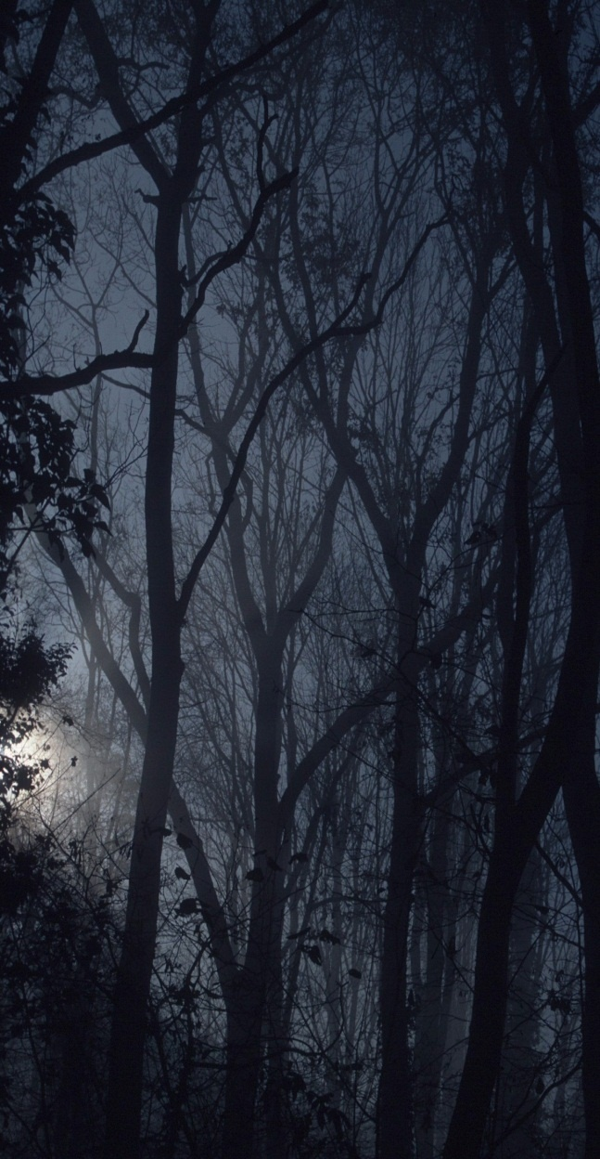
Risk: the two extremes
Science as a dangerous taboo: “You must not eat from any tree of the garden”
Notes:
We could run the risk of beginning to think that maybe the world out there is dangerous and scary. We either find no answers or dangerous answers. We could retract from the study of the natural world, discourage it. A view that is scared of the world, of what we may find; Is this the attitude God wants for us? This reminds me of the first who insinuated this idea: Really? God does not want you to know; science as taboo.

Slide 22
Risk: the two extremes
Science without God
“You will be like God”
“You shall not die”
Notes:
But there is also another lie that was said in front of that tree: you will be like God; What is that tree? It represents the possibility to be the one who calls the rules. A science without God, that doesn’t need God. We know everything, filled all the gaps: there was no God in the gaps, and there is no God anywhere. An orphan, self-contained world. There could not be two more extreme opposites: No God anywhere or God everywhere “in Him we live, and move, and have our being,” as Paul said.

Slide 23
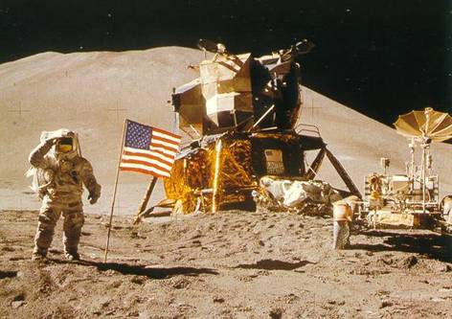
Colonel James Irwin
‘Lord, is it all right if we come to visit this place?’
“It's all right as long as you give Me the honor.”
Notes:
The presence of this tree of the knowledge of good and evil, creates an intricate relationship with knowledge. In a broken world, we find ourselves often asking the question: are we bringing glory to you or misleading others away from you? Astronaut who walked on the moon. When asked in an interview what he would have said were he able to dialogue with God while on the moon, he answered: “I would have said… And how did he think God would answer?
See, Naturalists do not have this restraint. Sometimes we hear the good argument that Christianity favored the development of science, because it looked at the creation as distinct from God, and took away fear from its study. Naturalists take that to the extreme: essentially to a place where there are no ethical boundaries. With the knowledge of good and evil there are no limits. To some this is attractive and desirable. But it turns out that this fruit can lead to very dark places. So…

Slide 24
Bad Rep: 4) Creationists have limited answers
if being a creationist means to freely move in the garden but accept the limits that come from not being God, then yes…I want to be a creationist.

Slide 25
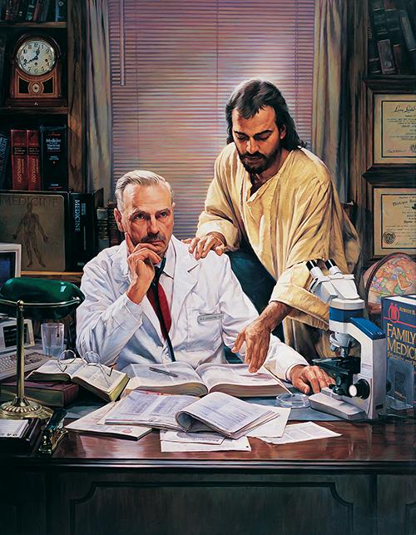
Creationist Researcher: Foundational Differences?
Biblical worldview:
impact on research?
practice and vision
Nathan Greene, The Difficult Case. Used with permission
Notes:
In other words, we are asking if the Christian experience and biblical worldview have a distinctive impact on the practice of research and vision for research
I believe that this is the case, in at least three major ways. Let’s explore together these foundational areas that set aside the Christian researcher

Slide 26
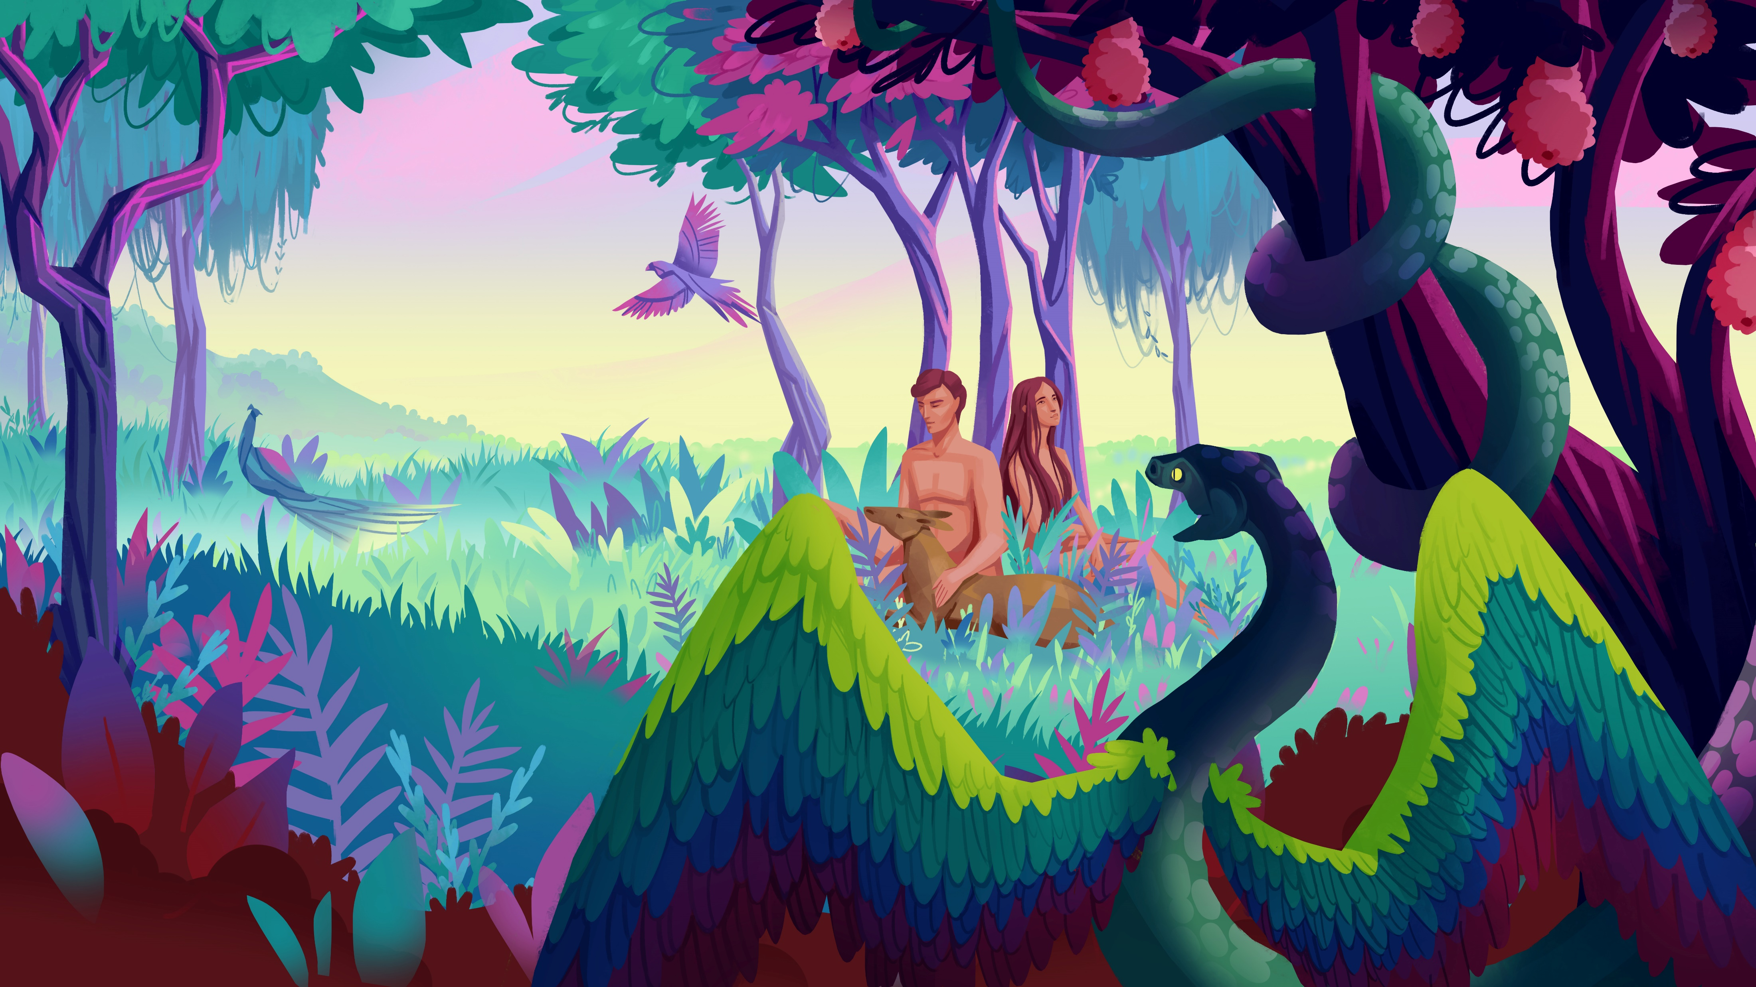
Humans, knowledge, and God
“Of the tree of the knowledge of good and evil you shall not eat, for in the day that you eat of it you shall surely die.” Gen 2:17
“When the woman saw that the tree was good for food, that it was pleasant to the eyes, and a tree desirable to make one wise, she took of its fruit and ate.” Gen. 3:6
Notes:
Let’s start form the beginning, shall we? And I mean our real beginning. If research is about acquiring new knowledge, we find some passages in Genesis that are very relevant to the quest for knowledge. First we learn that God instructed humans not to eat from the tree of the knowledge of good and evil. The effect of eating from it would be certain death. Then we learn that the fruit of that tree was desirable to make one wise, so it involved an important intellectual component. This seems somehow problematic at first sight. Is knowledge, and therefore research, dangerous? Should we infer that God is anti-knowledge?

Slide 27
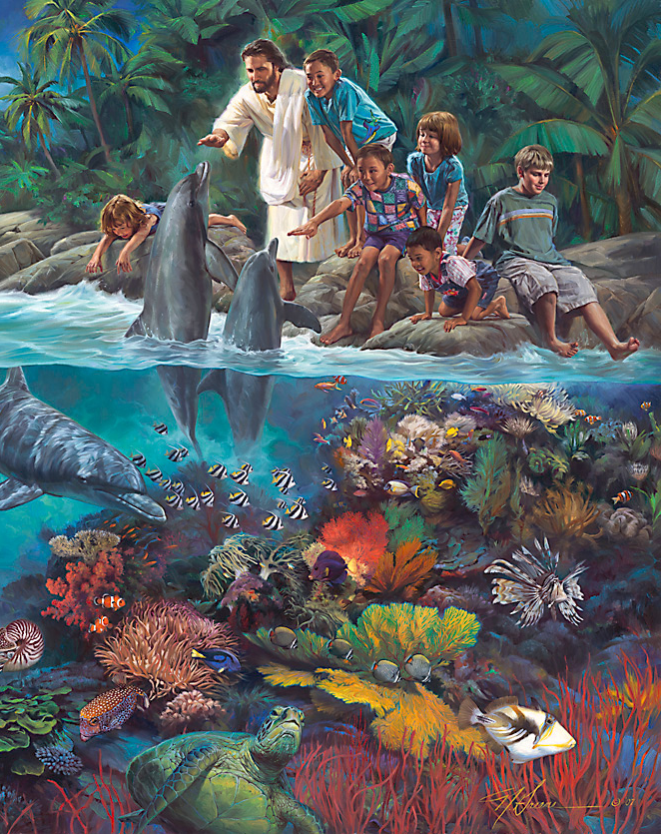
Is God Anti-Knowledge?
God invites participation (naming animals, tending the garden)
God shares information (do not eat of the fruit of the tree of the knowledge of good and evil)
God provides wholesome experiences (of every tree of the garden you may freely eat)
Nathan Greene, The Lord God Made Them All. Used with permission
Notes:
If we look at the full picture in Genesis, we realize that this cannot be the case, God is absolutely not anti-knowledge. There are various elements in Genesis itself to prove this. For example…

Slide 28
“Vast was the scope offered for their exercise, glorious the field opened to their research. The mysteries of the visible universe—the "wondrous works of Him which is perfect in knowledge" (Job 37:16)—invited man's study. Face-to-face, heart-to-heart communion with his Maker was his high privilege.”
EG White, Education, p.15
© Nathan Greene, Days of Creation, Day 7,
used with permission

Slide 29
“Of the tree of the knowledge of good and evil you shall not eat, for in the day that you eat of it you shall surely die.” Gen 2:17
“You will not surely die. For God knows that in the day you eat of it your eyes will be opened, and you will be like God, knowing good and evil.” Gen 3:4-5
Notes:
What is then the issue? It is not knowledge in itself. The tree that we should not eat from is not called the tree of knowledge, but the tree of the knowledge…of good and evil. So what does the fruit of this tree represent? We can look at the words of the serpent to understand what it represents…. It represents the autonomous setting of good and evil. A choice of independence from God, a quest for subsistence apart from Him and His principles. In a sense, if the fruit of the tree of life symbolizes accepting God’s provision of sustenance, the fruit of this other tree is a rejection of that connection and sustenance. And therefore, If one tree brings life the other brings death. You cannot have both at the same time. Either you are dependent or independent. Therefore, when it comes to knowledge, it is the “orphan” pursuit of knowledge that is fundamentally problematic for the Christian researcher. A knowledge sought outside of a relationship with God. In a secular society, the pursuit of knowledge is seen as a value in itself. The motifs or context for that search are secondary. As researchers, our fascination is captured by the trailblazers, the iconoclasts, our heroes are those who pushed the boundaries of knowledge, no matter what. Humanity has always had a fascination with this type of independent, unimpeded characters, perhaps most aptly captured in the mythological figure of Ulysses.

Slide 30
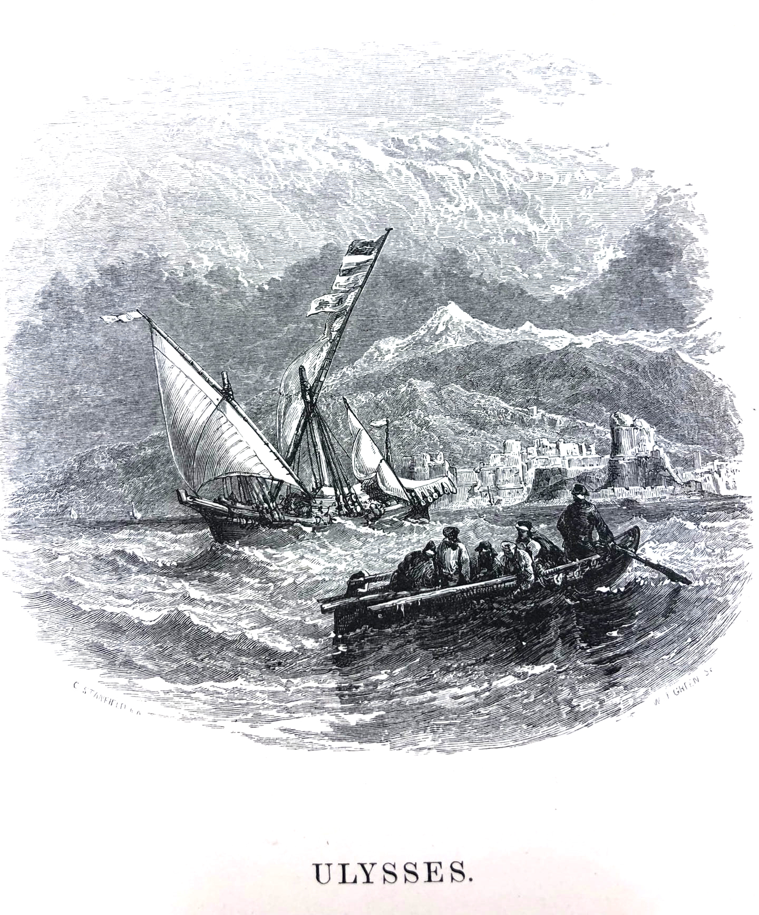
Ulysses and the Pillars of Hercules
"Fatti non foste a viver come bruti
ma per seguir virtute e canoscenza"
(You weren't made to live like beasts, but to follow virtue and knowledge)
Dante Alighieri, Inferno, Canto XXVI
“To follow knowledge like a sinking star,
Beyond the utmost bound of human thought.”
Lord A. Tennyson, Ulysses
Notes:
The Italian poet Dante Alighieri, in his monumental work the Divine Comedy, encounters Ulysses among the damned in his journey through Hell. There, Ulysses recounts the last moments of his life, telling of when, in his old age, he convinced his companions to embark on one last journey, to cross the Pillars of Hercules, and sail beyond the limit of the known world. His words to them appealed to that instinct for knowledge:… A similar sentiment is captured in the romantic poem by Lord Tennyson, also depicting the uneasiness of the old Ulysses and his insatiable desire to explore the unknown:….

Slide 31
Knowledge in the context of a relationship
“Scientific research will open to the minds of the really wise vast fields of thought and information. They will see God in his works, and will praise him.”
Ellen G. White, Signs of the Times, 10:162, March 13, 1884
“Only under the direction of the Omniscient One shall we, in the study of His works, be enabled to think His thoughts after Him.”
Ellen G. White, Education, p. 134
Nathan Greene, The Creator. Used with permission
Notes:
What is then the difference between the treasured myth of the insatiable Ulysses and the divine ideal for research? For the Christian researcher, the greatest difference is that this is not a quest for knowledge for the sake of knowledge. It is a search in the context of a relationship with God. The Christian researcher can also be a trailblazer, full of thirst for knowledge. The fields of thought and information are vast and open for discovery. But this is not an orphan, God-free quest. It is a relational quest, which presupposes God, develops in connection with God, and ultimately points towards God. It is a quest that craves the direction of the Omniscient One.

Slide 32
Knowledge in the context of a relationship
“Whatever line of investigation we pursue, with a sincere purpose to arrive at truth, we are brought in touch with the unseen, mighty Intelligence that is working in and through all. The mind of man is brought into communion with the mind of God, the finite with the Infinite. The effect of such communion on body and mind and soul is beyond estimate.
In this communion is found the highest education. It is God's own method of development. "Acquaint now thyself with Him" (Job 22:21).”
EG White, Education p.14
Notes:
Read quote. The ultimate goal of the Christian researcher is not to acquire new knowledge but to create a deeper bond with God, through a process that follows a trajectory of exploration, wonder, appreciation, and trust. Don’t you crave for this incredible experience? The ultimate goal of our investigation is to create this communion with God.

Slide 33
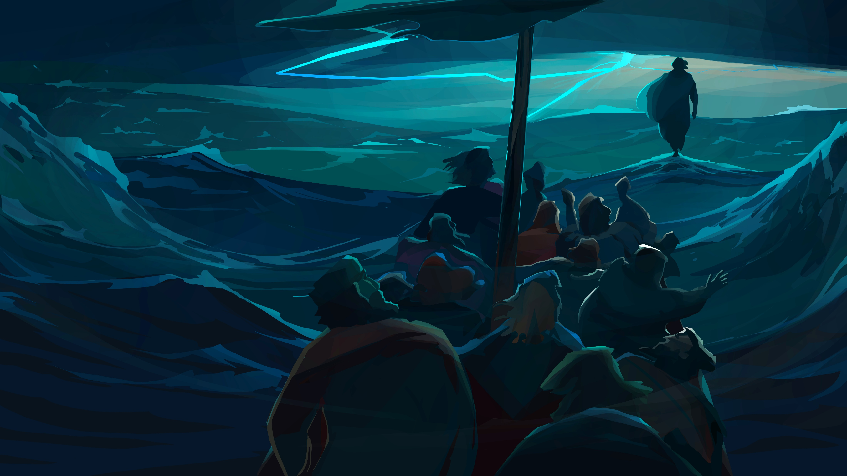
“Then Jesus turned, and seeing them following, said to them, “What do you seek?”
They said to Him, “Rabbi” (which is to say, when translated, Teacher), “where are You staying?”
He said to them, “Come and see.” They came and saw where He was staying, and remained with Him that day.”
John 1:38-39
Notes:
This is the communion that Jesus invites us to have with Him, exemplified by the encounter from which the title of this presentation is taken. … What are we seeking? Why do we seek? We seek to dwell. Ultimately, the best seeker is really a follower.

Slide 34
Creationist Researchers: Care and Conduct
“By this everyone will know that you are my disciples, if you love one another.” (John 13:35)
“Beloved, if God so loved us, we also ought to love one another.” (1 John 4:11)
“And though I have the gift of prophecy, and understand all mysteries and all knowledge, and though I have all faith, so that I could remove mountains, but have not love, I am nothing.” (1 Corinthians 13:2)
Notes:
A second area where Christian researchers should exhibit distinctiveness is personal character. Excellence, integrity, and compassion are virtues that are valued in many contexts and communities, not just Christianity. However, research and academia can also be hyper-competitive environments, with high-stakes and high-pressure, jealousies, and conflict. In this complicated context, Christian researchers bring something more than just a moral imperative to integrity of conduct. If we are true Christians we will bring love, care, and compassion in the workplace and in our academic interactions. Jesus defines love as the diagnostic quality of a Christian…. Something that flows from experiencing Christ’s love for us, because …. We could have all the knowledge and understand all the mysteries, but if we lack love… we are nothing. And I recognize that we are really crippled lovers, that operate in difficult conditions, and that this flow of love in our interactions is faulty and intermittent. But love is a necessary condition to be called a Christian researcher. We cannot compartmentalize our conduct and our academic results.

Slide 35
Creationist Researchers: Missional Focus
“Peace to you! As the Father has sent Me, I also send you.” (John 20:21)
Notes:
Finally, a third distinctive aspects of Christian researchers is that they will place their research interests and efforts in the context of the Great Commission. Their driver and purpose for research will be missional. A desire to serve others, share the gospel, benefit humanity, heal, teach, and lead towards Christ. The specific forms in which these efforts take place and are manifested are as varied as God’s imagination and the talents He bestowed upon us, but Christian researchers are united by this missional identity and sense of calling. They research for mission, they research for service.

Slide 36
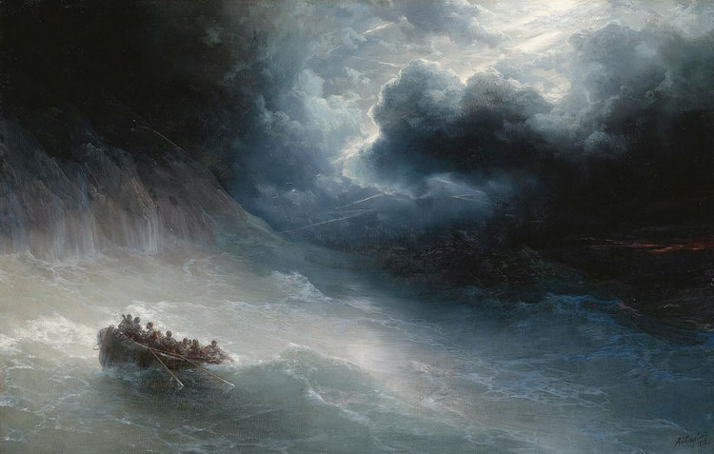
Notes:
Ultimately, being a creationist consists in the choice of recognizing Jesus Christ as the Creator and sustainer of the world. No one is forcing us to take this step. It’s a free choice. It’s a conviction we mature, a beautiful expression of free will. Like Peter, on the edge of the boat, looking at the figure of a man walking on water, you may feel the urge to say: if all of this is true, tell me to walk on water. Are you really ready for this journey? Because Christ will give you a simple answer: come.

