Slide 1
The Biblical Foundation for Adventist Education
Adventist
Education
By E. Edward Zinke
Illustrations by David Zinke
and Carol Raney
Motivation by Doug Zinke
and by Seven Grandchildren
Notes:
*

Slide 2
The Authority of the Bible in the History of Theology
To the Reformation

Slide 3
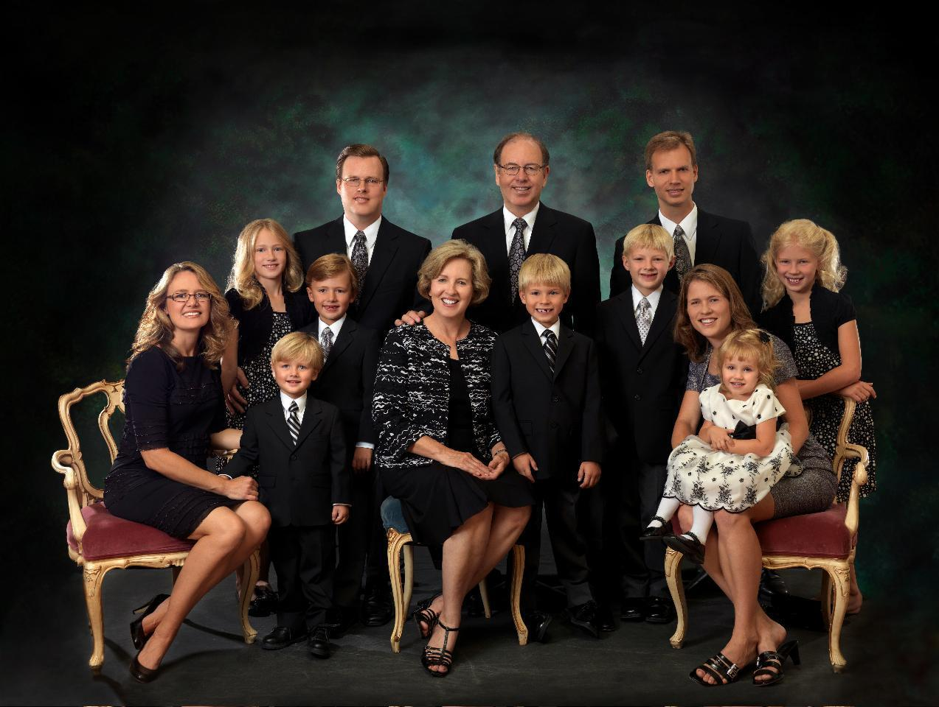

Slide 4
Epistemology
Notes:
Epistemology is the path we take. Our destination is determined by our epistemology. It also determines the destiny of our students.
*

Slide 5
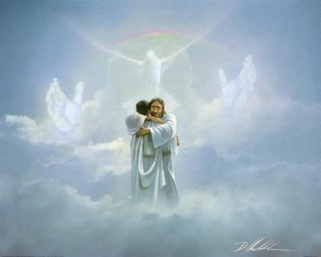
Epistemology
Notes:
*

Slide 6
Epistemology
Notes:
This in turn has implications for our self understanding, the purpose of our existence, our knowledge of the world in which we live, our concept of what the universe is like, and finally, who God is.
*

Slide 7
Epistemology
Notes:
When our epistemology changes…(click)
*

Slide 8
Self
Existence
World
Epistemology
Universe
God
Notes:
… our concept of the universe, of ourselves, and of God changes as well.

Slide 9
Notes:
We live in a world that is bombarded from all sides with many differing world views, with humanistic ways of thinking. From the classroom, to the news media, to television programs, to everyday life in the work place, we are taught to think humanistically.
*

Slide 10
Rock-solid
foundation
Notes:
We seek a rock solid foundation upon which to base our knowledge.
*

Slide 11
Reason
Math
EXPERIENCE
AND MYSTICISM
Science
Notes:
In our culture, that world view is built upon the unmovable successes of reason, science, and mathematics and experience and in so doing, we fail to recognize that we have just made them the foundation of our life. Human kind in one way or another becomes the authority.
*

Slide 12
Notes:
Notes – Humankind in one way or another becomes the foundation, the authority for our understanding of the universe including God, origins, ourselves, our destiny, etc.
*

Slide 13
Notes:
This seminar will call for a paradigm shift from humanism… that is, some aspect of humanity as the basis for what we know, believe, understand to God’s Word as that foundation.
*

Slide 14
Holy Bible
Notes:
…to biblical thinking.
*

Slide 15
How Will We Get There?
Existentialism
Overview of the history of philosophy, theology and Biblical studies highlighting lessons learned
The Biblical world view as foundational for our understanding of the world – that rock solid foundation we were seeking above
Notes:
We will only attempt a brief tour of the history of philosophy and theology and we will discuss the implications of the Bible and the writings of E. G. White for foundations for our understanding of the world.
*

Slide 16
Presuppositions
The Bible, God’s Word, came by the will of God rather than by the will of man
The Bible is its own interpreter
Notes:
See presentations by Dr. JoAnn Davidson and Dr. Richard Davidson

Slide 17
Terminology
Rationalism
Empiricism
Existentialism
Pragmatism
Materialism
Ectceteraism
Notes:
First of all – Some Terminology
Ectceteraism – a manufactured term for any system which has its foundation in humankind.
*

Slide 18
Early Church 2nd-12th centuries
The early church was dominated by the philosophy or world view of Neo-Platonism. This philosophy was inherited from Greek philosophy, primarily from Plato.
Notes:
*

Slide 19
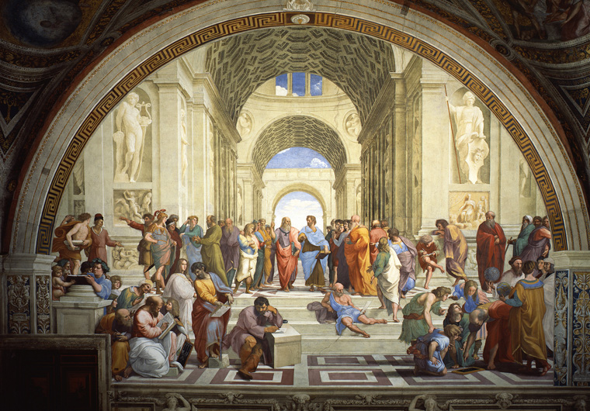
Neo-Platonism
Notes:
The School of Athens
add description of picture
Including – in Vatican – yet figures are primarily Greek philosophers.
http://search.aol.com/aol/image?q=School+of+athens&s_chn=wm_t19&v_t=webmail-searchbox
(picture from Museos Vatican's)

Slide 20
Neo-Platonic Philosophy
Celestial/Perfect/Eternal Forms
Imperfect/Earthly
Materialization of these forms
Notes:
The early church was dominated by Neo-Platonic world-view thinking. The universe was ordered by a hierarchy, from perfect eternal forms to earthly imperfect instances of these forms.
*

Slide 21
Neo-Platonism
Perfect/Eternal Form or Idea (Real)
Imperfect/Earthly/Material
(Merely a Reflection of the Real)
Notes:
The really real was not the material, but the eternal forms.
Neo-Platonism was formative for the theology of the Early Christian period. The idea of the natural immortality of the soul was brought into the unsuspecting church;
*

Slide 22
Neo-Platonic Philosophy
Perfect/Eternal Form
Imperfect/Earthly
Notes:
Knowledge emanated from the eternal forms through the hierarchy of being,
*

Slide 23
The Goal of Neo-Platonism
Celestial/Perfect/Eternal
Imperfect/Earthly
Return to the Eternal Form
Notes:
and the goal of earthly instances was to return to the eternal form.
*

Slide 24
Neo-Platonism
Perfect/Eternal
(Real)
Imperfect/Earthly/Material
(Not Real)
Return to the really real
Notes:
The goal of life – of all earthly being - was to return to and be re-united with the eternal form from which it came.
*

Slide 25
Neo-Platonism
Perfect/Eternal
(Real)
Imperfect/Earthly/Material
(Not Real)
Notes:
The goal of life – of all earthly being - was to return to and be re-united with the eternal form from which it came.
*

Slide 26
Influence on Theology
Neo-Platonism had a major impact on the theology of the Christian Church.

Slide 27
Natural Immortality of the Soul
Perfect/Eternal/Soul
(Real)
Imperfect/Earthly/Body
Notes:
Since the body was not the essence of reality, the material body was of less consequence. It was the soul that mattered. The soul was eternal since it came from the eternal form and would return to it. Since the soul partook of the essence of the universe, and since essence was eternal, the soul was immortal.
*

Slide 28
Knowledge of God
Since reality was only accessible through intermediaries, God also was only known and approachable through intermediaries.

Slide 29
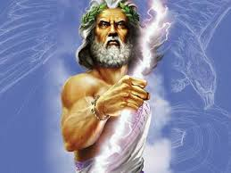
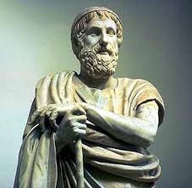
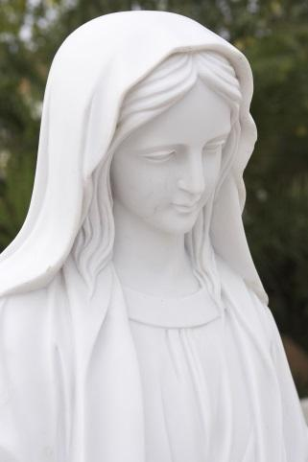
Notes:
Thus Mary, the Church and the saints were essential intermediaries to our relation with God.
*

Slide 30
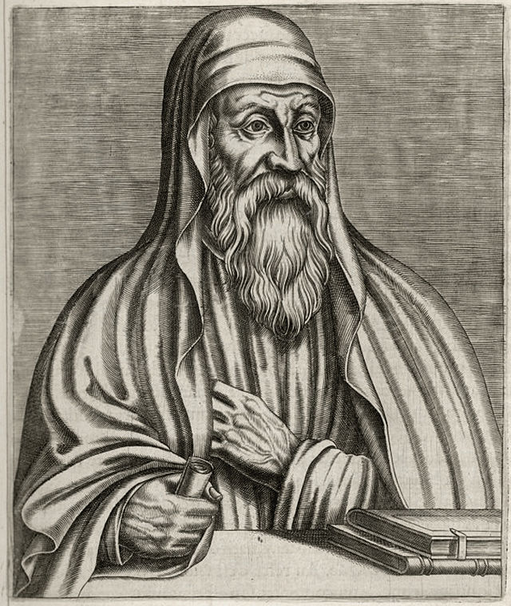
Origen
Early Church | Middle Ages Dark Ages 500s-1500s | Renaissance 1300s-1600s Reformation 1500s | Enlightenment Age of Reason 1600s-1700s | Modernism Post-Modernism
3rd century
Notes:
Origen – from Alexandria, a Greek city with Neo-Platonic world view –
Converted to Christianity, brought his world view with him.
Reference: Origen, Illustration from "Les Vrais Portraits Et Vies Des Hommes Illustres" by André Thévet

Slide 31
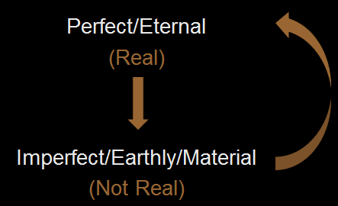
Allegorical Method of Interpretation came from Neo-Platonism through the Jew, Philo
Neo Platonism
Origen
Notes:
Origen was strongly influenced by his time, especially by Neo-Platonism and its attendant method--the allegorical method of interpretation introduced by the Jew, Philo as a method for the study of the Old Testament was broadened to include the New Testament writings.
*

Slide 32
Hermeneutics
As we have seen, Neo-Platonism held to the dual concept of eternal realities and their reflection in earthly forms. This influenced their understanding and interpretation of literature. Literature had a literal meaning, but more importantly and often distinctly, an allegorical interpretation, the really real.
Notes:
There might be some way of depicting this
Ed: see next slide for my idea of how to depict this. In the notes section it tells you where to click. Put it in presentation mode to see the animation.
*

Slide 33
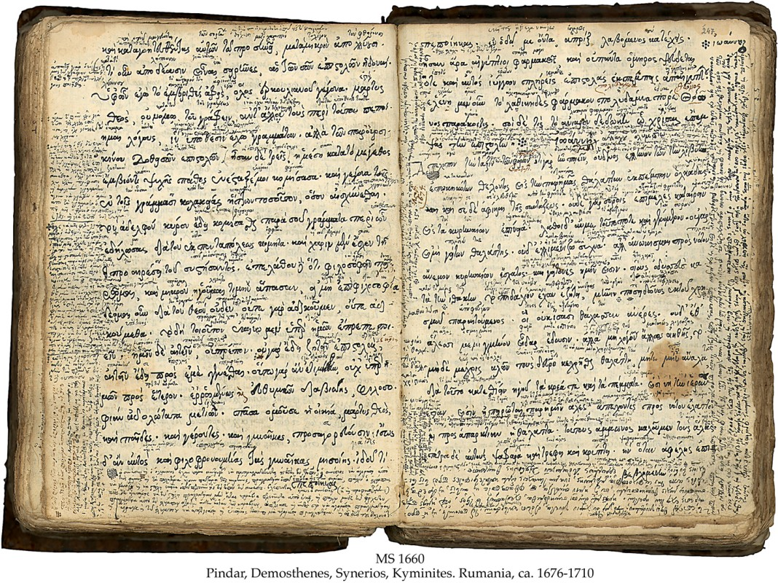
Literal
Allegorical
Notes:
As we have seen, (click) Neo-Platonism held to the dual concept of eternal realities and their reflection in earthly forms. (click) This influenced their understanding and interpretation of literature. (click) Literature had four possible meaning ranging from a literal meaning, through and more importantly(click) an allegorical or spiritual interpretation.
If possible, re-arrange so that text is on the left going to the right is the literal at the bottom and allegorical at the top.
Ed: I’m not sure what you’re saying here. I’ll try something on the next slide, but let me know if you want something different.

Slide 34
Spiritual
Figurative
Allegorical
Literal
Notes:
As we have seen, Neo-Platonism held to the dual concept of eternal realities and their reflection in earthly forms. (click) This influenced their understanding and interpretation of literature. (click) Literature had four possible meaning ranging from a literal meaning, through and more importantly(click) an allegorical or spiritual interpretation.

Slide 35
Allegorical
&
Literal
Notes:
Origen’s concept of Scripture (click) paralleled the secular, Neo-Platonic concept (click) of the nature of literature (click)
Notice statue of Plato http://www.wisegeek.org/what-is-the-allegory-of-the-cave.htm
I don’t know if there is some way of depicting Neo-Platonism. I think this illustration conflicts with the latter one where enlightenment theology reflects man’s self concept.
Might be something in Plato that will give us some ideas – the shadow in the cave??
Let’s keep this in case we can use it http://us.yhs4.search.yahoo.com/yhs/search;_ylt=A0LEV7oX6MtTpEYAaM2l87UF?p=plato%2C+shadoes+in+the+cave&fr=sfp&fr2=&type=W3i_SP%2C203%2C0_0%2CStartPage%2C20140207%2C20033%2C0%2C25%2C0&hspart=w3i&hsimp=yhs-syctransfer&iscqry=
http://en.wikipedia.org/wiki/Allegory_of_the_Cave
http://www.historyguide.org/intellect/allegory.html
https://www.youtube.com/watch?v=K_7W-Bmu3wo
http://www.wisegeek.org/what-is-the-allegory-of-the-cave.htm
*

Slide 36
Levels of Meaning
Spiritual
Figurative
Allegorical
Spiritual
Literal
and/ or
Notes:
…namely that there are four basic levels of meaning, for all practical purposes, summarized as two—the literal, and the figurative, allegorical, or spiritual

Slide 37
When a literal interpretation was…
Unworthy of God
Impossible (based upon the contemporary thinking of the age)
Not in harmony with other passages of Scripture
Literal
Notes:
When a literal meaning would be out of harmony with that which is worthy of God, would make an interpretation impossible (based upon the contemporary thinking of the age), or when a literal meaning would not otherwise be in harmony with other passages of Scripture… then one must seek an allegorical meaning
*

Slide 38
An allegorical interpretation was demanded
Spiritual
Figurative
Allegorical
Spiritual
Literal
and/ or

Slide 39
Theology
Notes:
Origin’s intention was to use the Bible as the authority for his theology.
*

Slide 40
Notes:
But because he accepted uncritically the hermeneutics of his time, the Bible became a neo-platonic book.
*

Slide 41
Origen--Lessons Learned
Came from Alexandria, a city of Greek culture in Egypt
Accepted Neo-Platonic worldview/philosophy of Alexandria
The allegorical method of interpretation was a product of Neo-Platonic thinking
He used this external method and thereby imposed Neo-Platonism on the Bible

Slide 42
Origen--Lessons Learned
By applying the allegorical methods to the study of scripture, he imposed the Neo-Platonic worldview upon scripture. Scripture became a good Neo-Platonic book.
His intention was mission—to reach people where they are, but the result was compromise, the baptism of Christianity by a pagan culture, and the obscuration of the Bible.
Notes:
Ed – EGW quote - compromise

Slide 43
Notes:
*

Slide 44
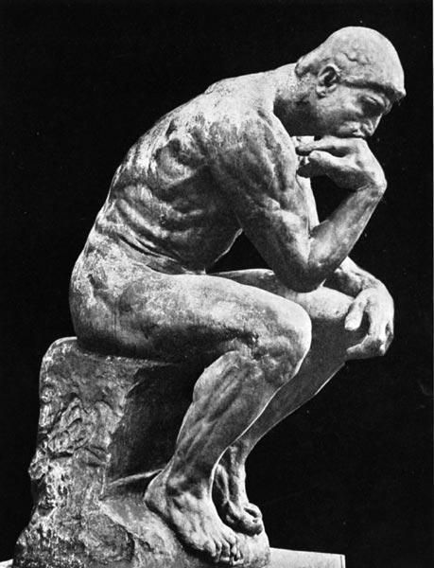
Middle Ages
Early Church | Middle Ages Dark Ages 500s-1500s | Renaissance 1300s-1600s Reformation 1500s | Enlightenment Age of Reason 1600s-1700s | Modernism Post-Modernism
Notes:
A basic change in concept of the authority of Scripture took place in the middle ages. (click for picture of Bible) Up to that point, theologians intended, in spite of their Platonism, to be Biblically faithful to Scripture. (click for philosophy statue) However, with the introduction of Aristotle in the eleventh century, the authority of philosophy became more predominant, (click to remove Bible) and at times replaced that of Scripture altogether.
*

Slide 45
Philosophical Arguments for the Existence of God
The Bible simply assumes the existence of God.
Some theologies of the middle ages attempted to prove His existence.
These arguments encased God within the philosophy of the age.

Slide 46
Anselm
Reason puts man in touch with the whole order of being and has its own principles of operation. Therefore reason gives a foundation for accepting the existence of God.
Notes:
Ed: Do you want an introductory slide for Anselm with timeline/century and picture? If so, what century?

Slide 47
How do we know such a being as God exists?
By an argument that arises from a definition of God?

Slide 48
Ontological Argument for Existence of God
God: a being greater than which nothing can be conceived.
Notes:
The ontological argument for the existence of God arose out of a definition of God: God is a being than which nothing greater can be conceived.
*

Slide 49
Nothing can be greater than the greatest being
God = Greatest Being
Notes:
God is the greatest being. (click for bar and bubble) It is not possible for anything greater (above the line) to exist…

Slide 50
Ontological Argument for the Existence of God
All men have as an object of thought, the idea of a being that which nothing greater can be conceived
Notes:
Even the fool who says in his heart there is no God has in his mind the idea of the greatest being.
*

Slide 51
Ontological Argument for the Existence of God
The question is whether such a being exists in reality
?
Notes:
The question is whether such a being exists in reality.
*

Slide 52
To deny existence to this greatest being would be a contradiction in terms
God = Greatest Being
Notes:
To deny existence to this greatest being would be a contradiction in terms

Slide 53
For if such an object does NOT exist…
God = Greatest Being
Notes:
For if such an object does not exist…

Slide 54
Then we CAN think of another being which is greater by reason of existence than the being of which nothing greater can be conceived.
God = Greatest Being
Notes:
then we CAN think of another being which is greater by reason of existence than the being of which nothing greater can be conceived.

Slide 55
existence
Greater than
Non-existence
God = Greatest Being

Slide 56
Ontological Argument
Nothing
God = Greatest Being
God = MUST EXIST
Notes:
Such a conclusion would be contradictory and absurd. Therefore the being of which nothing greater can be conceived must exist in reality.

Slide 57
Reality
Thoughts
What is conceivable necessarily exists
Notes:
Anselm’s argument was framed within a thought world which assumed a necessary relationship between thought processes and reality. (click) What is conceivable of necessity exists in reality and in God
*

Slide 58
God
Notes:
Have picture of the thinker– and representation of God – above.
Can we somehow use the representation of God that you have in slide 30 in place of God.
Ed: At least at one point, the representation of God on slide 30 was this picture of heaven/clouds. Is this what you meant?
Was thinking of Zeus
*

Slide 59
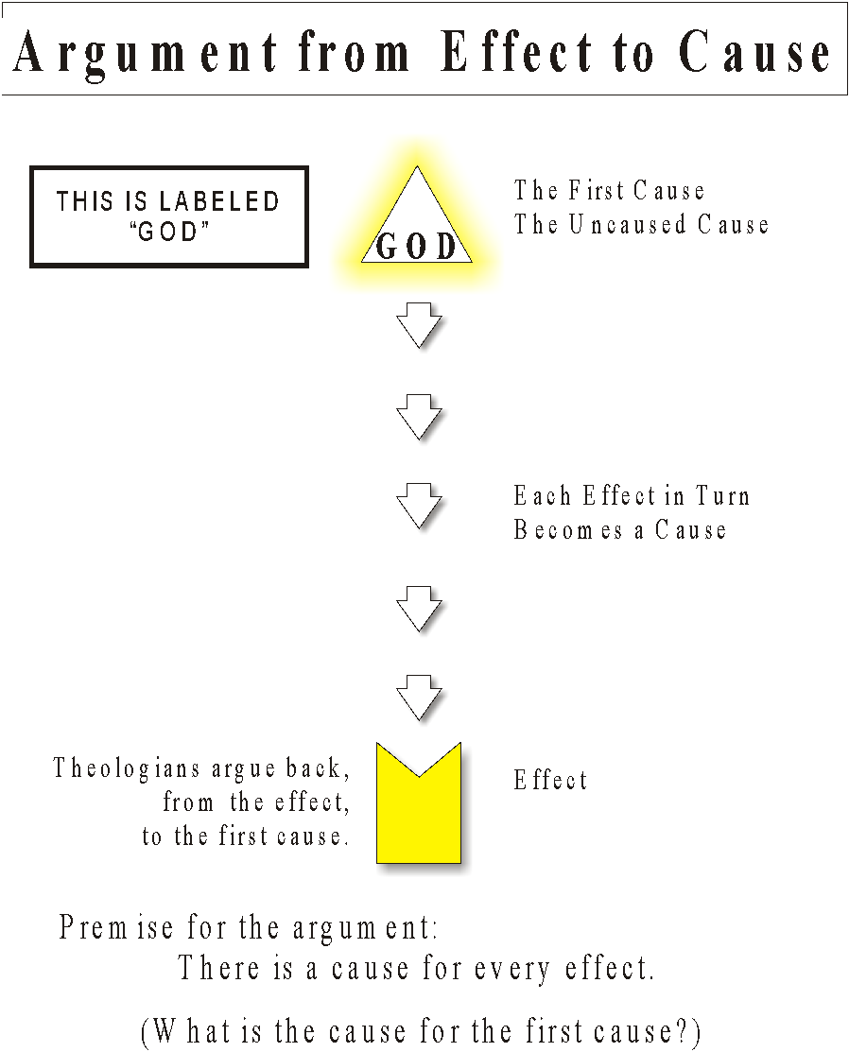
Notes:
*

Slide 60
Argument from Design
Notes:
*

Slide 61
Notes:
*
*

Slide 62
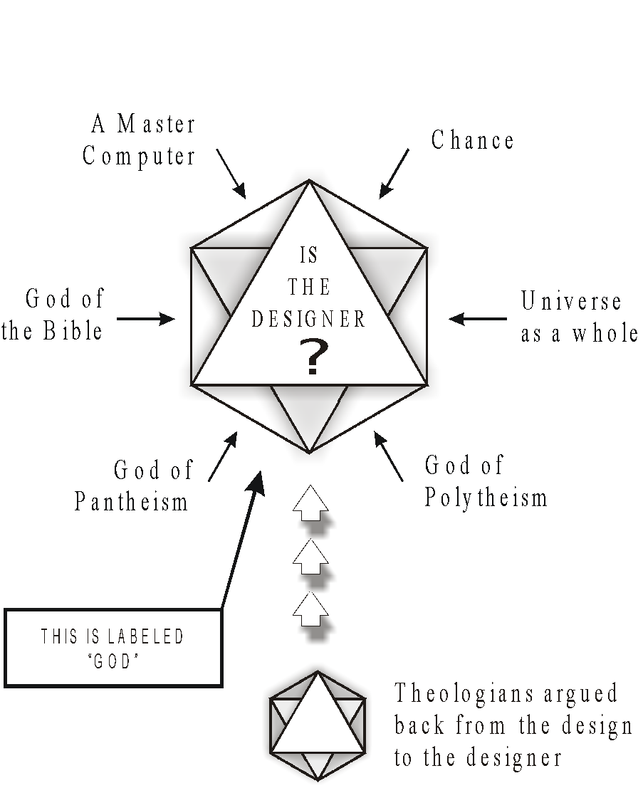
Notes:
*
Who is the God of design. Apart from the Bible, there are many answers to that question. Philosophically, it is impossible to discern between them.
*

Slide 63
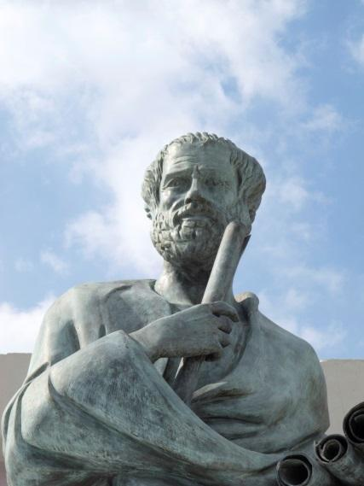
Scholasticism
Early Church | Middle Ages Dark Ages 500s-1500s | Renaissance 1300s-1600s Reformation 1500s | Enlightenment Age of Reason 1600s-1700s | Modernism Post-Modernism
Aristotle’s understanding
of the world
Notes:
Scholasticism of the Middle Ages was dominated by Aristotelian philosophy and its understanding of the natural world.

Slide 64
Thomas Aquinas
Early Church | Middle Ages Dark Ages 500s-1500s | Renaissance 1300s-1600s Reformation 1500s | Enlightenment Age of Reason 1600s-1700s | Modernism Post-Modernism
13th century
Notes:
Artwork: An altarpiece in Ascoli Piceno, Italy, by Carlo Crivelli

Slide 65
Thomas Aquinas
&
&
&
&
&
Truths of Nature
(Aristotle’s understanding
of the world)
Notes:
Thomas Aquinas represents the most developed theology of the middle ages. For Him, the task of the theologian was to synthesize the truths of nature, i.e., the philosophy of Aristotle (who obviously rightly described the nature of the natural world) with the spiritual insight of the Bible. His model was the Bible AND the natural world.
*

Slide 66
Roman Catholic Church Tradition
Nature
Tradition
The pope
Church councils
Philosophy
Etcetera
&
Notes:
Thus Aquinas was within AND PART OF THE DEVELOPMENT OF the tradition of the Roman Catholic Church, where theology was of necessity based on the Bible AND nature, tradition, the pope, church councils, and philosophy.
*

Slide 67
Revelation
Primary role in the development of theology.
Gift communicated to the prophets and comes to us through Scripture.
Brings spiritual truths which would not otherwise be available by the exercise of human reason.
Provides the fundamental principles of theology
Not subject to debate
Not capable of rational demonstration.
Notes:
Revelation is given a primary role in the development of theology. Revelation is a gift communicated to the prophets and comes to us through Scripture. Revelation brings spiritual truths which would not otherwise be available by the exercise of human reason. Revelation provides the fundamental principles of theology which are not subject to debate nor capable of rational demonstration.
*

Slide 68
Scripture = the intended starting point
Notes:
The fundamental propositions of Scripture are the starting point or presuppositions of theological thinking.
*

Slide 69
The fundamental propositions of Scripture are the starting point or presuppositions of theological thinking.

Slide 70
Aquinas rejected even the immaculate conception on the basis of Scriptural testimony.
Notes:
*

Slide 71
Role of Reason
Fundamental propositions given by Scripture
Reason
Notes:
The fundamental propositions of Scripture are the starting point or presuppositions of theological thinking.
*

Slide 72
Epistemology of Aristotle--Aquinas
Data
from
Senses
Reason
Knowledge
Notes:
Aquinas accepted the epistemology of Aristotle, (click) that knowledge is based upon what the senses perceive. The senses provide data which, (click) when interpreted by reason, (click) yields knowledge.
*

Slide 73
Beyond Aristotle
Faith
Knowledge &Truth
Reason
Notes:
Aquinas furthermore went beyond Aristotle (click) by indicating that faith is also a road to truth. Thus, both reason and faith provided means of obtaining knowledge of God and the universe
*

Slide 74
God
Revelation
Natural World
Notes:
Since Revelation and the natural world have their source in the creation of God, they are in harmony with one another.
*

Slide 75
Independent of Revelation
God
Man
(Reason)
Natural World
Notes:
Human reason operating within the natural world is essentially independent of revelation, It is an adequate and self-sufficient instrument and operates upon its own laws in obtaining truth within the world of man’s natural experience as well as within limited aspects of the spiritual realm.
*

Slide 76
What is the relation between knowledge of the natural world and revelation from God?

Slide 77
Both revelation and reason bring knowledge to mankind.
Notes:
Both revelation and reason bring knowledge to mankind.
*

Slide 78
Revelation is given.
Revelation
Knowledge
Notes:
Revelation is given,
*

Slide 79
Reason interprets the data of the senses.
Data from senses
Reason
Knowledge
Notes:
whereas reason brings knowledge by interpreting of the data of the senses.
*

Slide 80
Revelation is given in accordance with reason.
Brings man’s natural reason to fuller perception.
Revelation
Knowledge
Data from senses
Reason
Knowledge
Notes:
Revelation does not come from reason but is given in accordance with reason. It does not alter man’s natural reason except by bringing what reason contains to fuller perception.
*

Slide 81
Revelation does not contradict reason.
Revelation does not imply correction.
Revelation
Knowledge
Data from senses
Reason
Knowledge
Notes:
The fact that revelation brings something new into the sphere of reason does not mean that there is a contradiction between reason and revelation. Revelation does not imply any correction of the structure which characterizes the work of reason.
*

Slide 82
Revelation does not contradict reason.
Revelation does not imply correction.
Revelation
Knowledge
Data from senses
Reason
Knowledge
Notes:
The new knowledge which is given in revelation is an extension of the knowledge gained through reason.
*

Slide 83
One Truth
God
Revelation
Reason
Notes:
Since all truth comes from one source, there is order and harmony within all knowledge. Thus, although revelation and reason deal with different (although not unrelated) realms of truth and although there are limits to the human mind, there is nonetheless only one truth.
*

Slide 84
Cannot be in Conflict
God’s Truth
God
Revelation
Reason
Notes:
God is the origin of both nature and revelation; therefore reason and faith have their source in God and cannot be in conflict with each other.
*

Slide 85
God has given
First principles of thought in the natural world
Articles of faith in the revealed word
Any conflict would mean that God was acting falsely by intending to deceive man.
Notes:
God has given both the first principles of thought in the natural world and the articles of faith in the revealed world. (click) If there were any conflict between faith and reason, it would mean that God was acting falsely by intending to deceive man.
*

Slide 86
Presuppositions
Thus, it is presupposed that God as the Creator will operate in accordance with the natural world as interpreted by reason.

Slide 87
Presuppositions
Therefore, our perception of who God is and how He will act is ultimately determined by our conception of the natural world.
Notes:
*

Slide 88
Presuppositions
Faith does not negate what is brought about by reason.
Faith presupposes the rational structure.
Notes:
Faith does not negate what is brought about by reason but actually presupposes the rational structure.
*

Slide 89
Truth is truth wherever it may be found.
God is the author of truth whether it is in revelation or in the natural world. There can be no contradiction between them.
Notes:
*

Slide 92
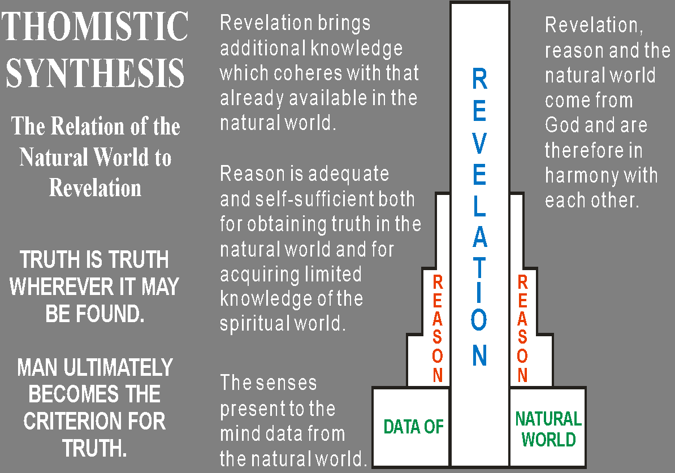
Notes:
Will leave as is – is a summary of what has gone before.
*

Slide 93
Task of Theology
Integration of Faith and Reason

Slide 94
Purpose of Theology
Determine and express the meaning and significance of the supernatural knowledge of God given in Scripture in order to reconstruct in a rational and human way the truth which God has been pleased to give in Scripture.
Notes:
The purpose of theology is to determine and express through the use of reason illuminated by faith the meaning and significance of the supernatural knowledge of God given in Scripture in order to reconstruct in a rational and human way the truth which God has been pleased to give in Scripture.
I will have to think about how best to show the inter-relationship.
*

Slide 95
Purpose of Theology
Revelation expresses the content of faith and is the starting point of the work of the theologian.
Starting Point
Notes:
Revelation as communicated in Scripture expresses the content of faith and is therefore the starting point for and presupposition of the work of the theologian.
*

Slide 96
Purpose of Theology
Reason
provides the basic structure within which the truths of revelation are organized.
Structure
Notes:
Reason provides the basic philosophical structure within which the truths of revelation are organized.
*

Slide 97
Scripture
Reason
Provides materials to be interpreted
Sets the limits to the philosophical system
Establishes the structure within which the content of revelation is expressed
Gives unity to the system of ideas
Notes:
The content of Scripture is normative in that it provides the basic materials to be interpreted and sets the limits to the philosophical system. (click) Reason, which is independent of revelation since it operates upon its own principles, is used to establish the structure within which the content of revelation is expressed. It is reason which gives unity and order to the system of ideas.
*

Slide 98
Reason in Theology
Finally, the role of reason in theology is both dominant and determinative.

Slide 99
Reason in Theology
The new information which is given in revelation is:
Integrated with knowledge obtained by reason
Interpreted in terms of that knowledge

Slide 100
Reason in Theology
Revelation does not abrogate the existing thought categories.
Rather it brings to conclusion the existing lines of thought by allowing reason to provide the structure for theology.

Slide 101
Reason in Theology
The message of Scripture is not only shaped by the philosophical system of thought but in actuality its content is also changed.

Slide 102
Reason in Theology
The net effect of using reason as the context in which to structure and interpret revelation transformed the theology of Aquinas into a philosophical system rather than a biblical theology.

Slide 103
Aquinas’s God
Aristotle’s Unmoved Mover
Active God of the Bible
Philosophy of the age
Notes:
Aquinas’s God began to take on the character of the Unmoved Mover of Aristotle (click) instead of the active God of the Bible. (click) The Bible, while considered the supreme authority, (click) became encased within the philosophy of the age.
We will want to envelop scripture with the current philosophy with whatever we choose above for Origen.
Ed: let me know which idea from above you prefer – waiting on David
I don’t see the options.
Whatever we decide above – will do here.
*

Slide 104
Lessons Learned
The epistemology of Aristotle was foundational
It was used as the basis for method in theology
Theology became an expression of the philosophy of Aristotle
Notes:
Summary – please make a slide
The epistemology of Aristotle was foundational
This was used as the basis for method in theology
Theology became an expression of the philosophy of Aristotle.

Slide 105
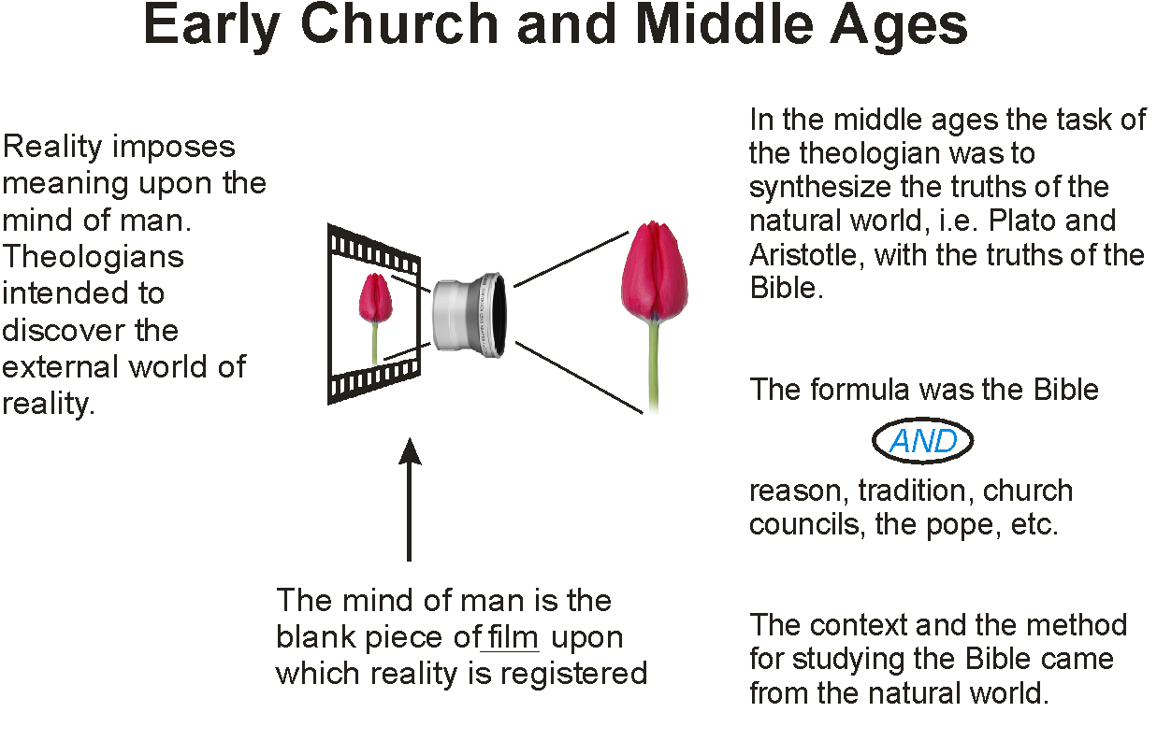
Notes:
*

Slide 106
Summary to the Time of the Reformation
&
&
&
&
&
The Bible
Tradition
Pope
Church Councils
Reason
Philosophy
The Natural World

Slide 107
Integration of Faith AND Learning
The theology of the middle ages exquisitely developed the method of the integration of faith and learning.
The Bible AND reason, the natural world, the pope, church councils, tradition, etc.
As we will see, the reformation brought the Bible back to its foundational role.
Notes:
Note to myself – the natural world provided the structure for understanding reality and thus for understanding theology. This was the basic world view.
*

Slide 108
Scholasticism built upon the rock
AND
The
Bible
Reason

