Slide 1
MISSIONARY VOLUNTEERS

Slide 2
STRATEGIC PLAN

Slide 3
KEY STRATEGIC ISSUES OF THE SECRETARIAT STRATEGIC PLAN
OBJECTIF
1
To revive the concept of worldwide mission and sacrifice for mission as a way of life involving not only pastors, but every church member, young and old, in the joy of witnessing for Christ and making disciples.

Slide 4
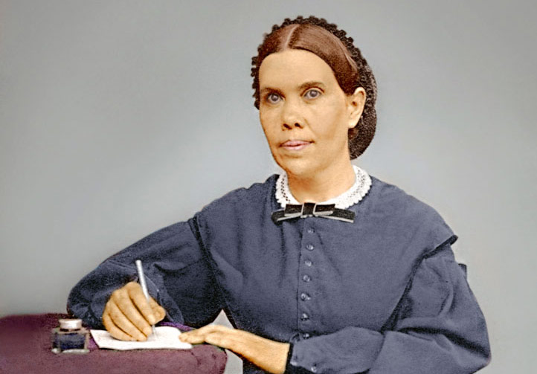
RATIONAL OF THE PROJECT
“The Lord has appointed the youth to be His helping hand”.—Testimonies for the Church 7:64.

Slide 5
RATIONAL OF THE PROJECT
“With such an army of workers as our youth, rightly trained, might furnish, how soon the message of a crucified, risen, and soon-coming Saviour might be carried to the whole world!”—Education, 271.

Slide 6
RATIONAL OF THE PROJECT
“We have an army of youth today who can do much if they are properly directed and encouraged. We want our children to believe the truth. We want them to be blessed of God. We want them to act a part in well-organized plans for helping other youth. Let all be so trained that they may rightly represent the truth, giving the reason of the hope that is within them, and honoring God in any branch of the work where they are qualified to labor.”—General Conference Daily Bulletin, January 29, 1893, 24.

Slide 7
PURPOSE OF THE PROJECT
In response to the above challenges and call, the method to achieve mission enthusiasm and strategy is to mobilize 1000 Adventist Young Missionary Volunteers across West-Central Africa Division (WAD) to serve in the various churches, mission/conferences, union and institutions within WAD by 2025.

Slide 8
PURPOSE OF THE PROJECT
The 1000 Adventist Young Missionary Volunteers Project is an inter-departmental initiative that will involve all departments and institutions within WAD.
As some will be providing the means to carry out the mission, others will be doing the training, the deployment of young volunteers for service and some other departments the evaluation.

Slide 9
PURPOSE OF THE PROJECT
The primary goal of the 1000 Adventist Young Missionary Volunteers is to train, send, and support 1000 missionaries by the end of year 2025. Inherent in this goal are three training objectives:
The first is to protect Adventist youth from evil influences of the world by instilling in them sound Christian principles during training and equip them for mission.
The second is to help finish the work of the gospel, particularly in unentered territories of West-Central Africa Division of the Seventh-day Adventist Church.
The third is to strengthen local churches through the volunteer missionary spirit of the missionaries.

Slide 10
QUALIFICATIONS TO BE AN ADVENTIST VOLUNTEER
YOU QUALIFY TO BE AN ADVENTIST VOLUNTEER IF YOU ARE:
Between 18 and 79 years of age (you must complete your service by your 80th birthday).
A baptized member of the Seventh-day Adventist® Church and have been in regular standing with the church for at least one year.
Financially able to serve without expectation of reward or compensation other than (possibly) a small stipend.

Slide 11
HOW CAN YOUNG PEOPLE SERVE?
Volunteers can serve either within their unions or outside their unions
They can serve for a short term of one week to 3 months, or for long terms of 4 months to 2 years.
They can work in any fields of their specialty or qualification

Slide 12
2023 FINANCIAL SUPPORT (CFA 50 Millions)
MISSIONARY VOLUNTEERS

Slide 13
1000 Young Missionary Volunteer Project
Project Fund For 2023: CFA 50,000,000 Distribution among entities: Unions – 1. Cameroon Union Mission CFA 2,000,000 2. Central Africa Union Mission CFA 2,000,000 3. Eastern Nigeria Union Conference CFA 2,000,000 4. Eastern Sahel Union Mission CFA 2,000,000 5. Northern Ghana Union Conference CFA 2,000,000 6. Northern Nigeria Union ConferenceCFA 2,000,000 7. Southern Ghana Union Conference CFA 2,000,000 8. West Africa Union Mission CFA 2,000,000 9. Western Nigeria Union Conference CFA 2,000,000 10. Western Sahel Union Mission CFA 2,000,000

Slide 14
WAD Institutions
Babcock University CFA 2,000,000
Valley View University CFA 2,000,000
Advent Press CFA 2,000,000
Other institutions:
Cosendai University CFA 1,000,000
Clifford University CFA 1,000,000
Adventist University of West Africa CFA 1,000,000

Slide 15
WAD MINISTRIES
1. Youth Ministries CFA 2,000,000 2. Health Ministries CFA 2,000,000 3. Stewardship Ministries CFA 2,000,000 4. Public Campus Ministries CFA 2,000,000 5. Women & Children’s Ministries CFA 2,000,000 6. Communication Department CFA 2,000,000 7. Education Department CFA 2,000,000 8. Family/Possibility Ministries CFA 2,000,000 9. Publishing Ministries CFA 2,000,000 10. Ministerial Association CFA 2,000,000
Secretariat CFA 2,000,000
Treasury CFA 2,000,000

Slide 16
HOW TO GET INVOLVED IN THE PROJECT AS DEPARTMENT OR ENTITY?
Sending a proposal to WAD Secretariat for consideration
Once the proposal is approved, WAD Treasury will disburse the fund
Departments, unions or institutions implement the project and send report to WAD Secretariat
Adventists Young Volunteers are celebrated at the end of the year.

Slide 17
MISSIONARY VOLUNTEERS

