Slide 1
Secretary’s Report 2022 Year-End Council
REFOCUSING ON MISSION
By Pastor Selom Kwasi Sessou
Executive Secretary

Slide 2
Renewal in WAD Secretariat Team
Executive Secretary
Selom Kwasi Sessou

Slide 3
Associate Secretary
Frederick Oluwale Falayi

Slide 4
Associate Secretary
Dr. Nathan Teye Odonkor

Slide 5
Administrative Secretary
David Kiminou

Slide 6
Administrative Secretary
Rene Kamonou

Slide 7
Administrative Secretary
Monica Fomuso Bakari

Slide 8
Administrative Secretary
Emah U. Same

Slide 10
SECRETARIAT MISSION
To provide administrative leadership and strategic direction to leaders within West-Central Africa Division in making disciples to reach the unreached, with integrity and in adherence to the organization’s strategic objectives, standards, and Christian principles.

Slide 11
SECRETATIAT METHODS
Strategizing mission priorities for the Division
Promoting awareness of and enthusiasm for mission to the unreached
Developing a comprehensive mission enterprise following Christ’s method
Facilitating the mobilization of resources for Mission
Supporting sound administration and fostering good governance

Slide 12
Secretariat Family Members
IPRS
RECORD CENTERS/ARCHIVES/STATISTICS

Slide 13
STRATEGIC PLAN

Slide 14
6 KEY STRATEGIC ISSUES OF THE SECRETARIAT STRATEGIC PLAN
OBJECTIF
1
OBJECTIF
2
OBJECTIF
5
OBJECTIF
8
OBJECTIF
9
OBJECTIF
10

Slide 15
6 KEY STRATEGIC ISSUES OF THE SECRETARIAT STRATEGIC PLAN
OBJECTIF
1
To revive the concept of worldwide mission and sacrifice for mission as a way of life involving not only pastors, but every church member, young and old, in the joy of witnessing for Christ and making disciples.

Slide 16
6 KEY STRATEGIC ISSUES OF THE SECRETARIAT STRATEGIC PLAN
OBJECTIF
1
Our Departmental reports will show clearly that our Women, Men, Youth and Children are very much involved in the mission of the Church alongside Pastors

Slide 17
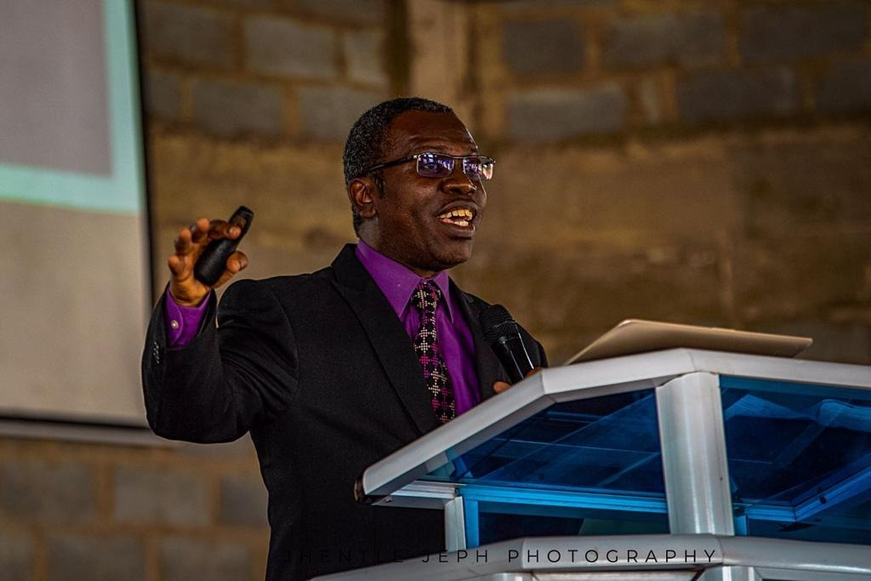
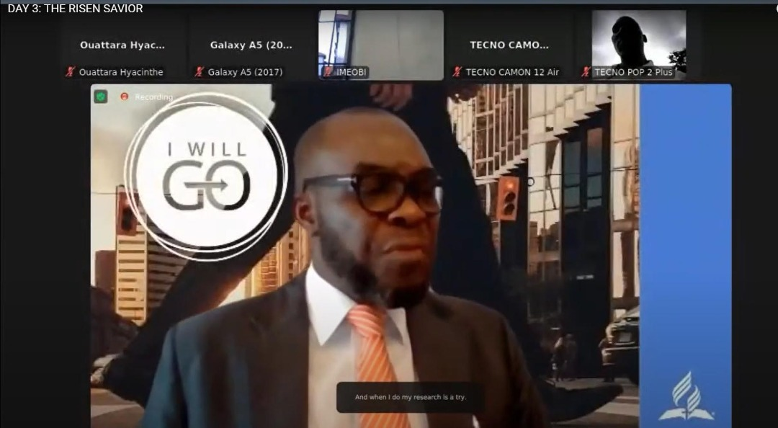
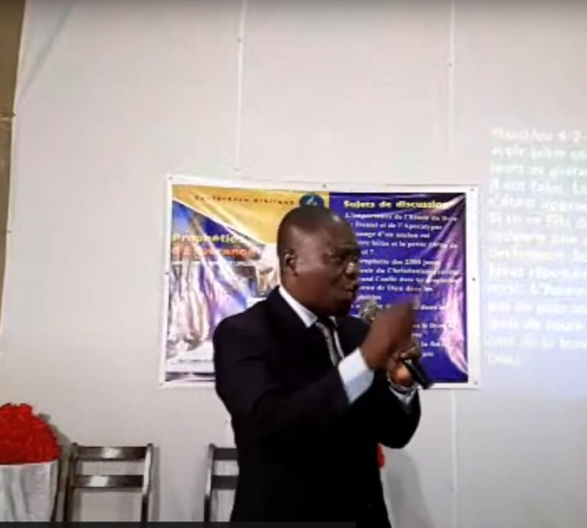
6 KEY STRATEGIC ISSUES OF THE SECRETARIAT STRATEGIC PLAN
OBJECTIF
1
Involving secretaries church clerks and secretaries at all levels in holding evangelistic efforts

Slide 18
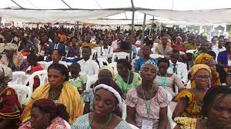
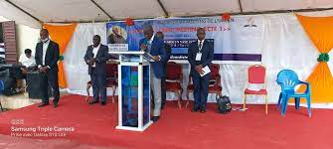
6 KEY STRATEGIC ISSUES OF THE SECRETARIAT STRATEGIC PLAN
OBJECTIF
1
Facilitate the presence of frontline missionaries, Global Mission Pioneers speaking at major camp meetings and other church gatherings.

Slide 19
6 KEY STRATEGIC ISSUES OF THE SECRETARIAT STRATEGIC PLAN
OBJECTIF
1
Increase the percentage of International Service Employees (ISE), volunteers, and Global Mission Pioneers serving in the 10/40 Window, in large urban areas, and among unreached people groups.

Slide 20
GLOBAL MISSION PIONNERS IN WAD

Slide 22
By Countries

Slide 23
By Unions

Slide 24
6 KEY STRATEGIC ISSUES OF THE SECRETARIAT STRATEGIC PLAN
OBJECTIF
2
To strengthen and diversify Adventist outreach in large cities, across the 10/40 Window, among unreached and under-reached people groups, and to non-Christian religions

Slide 25
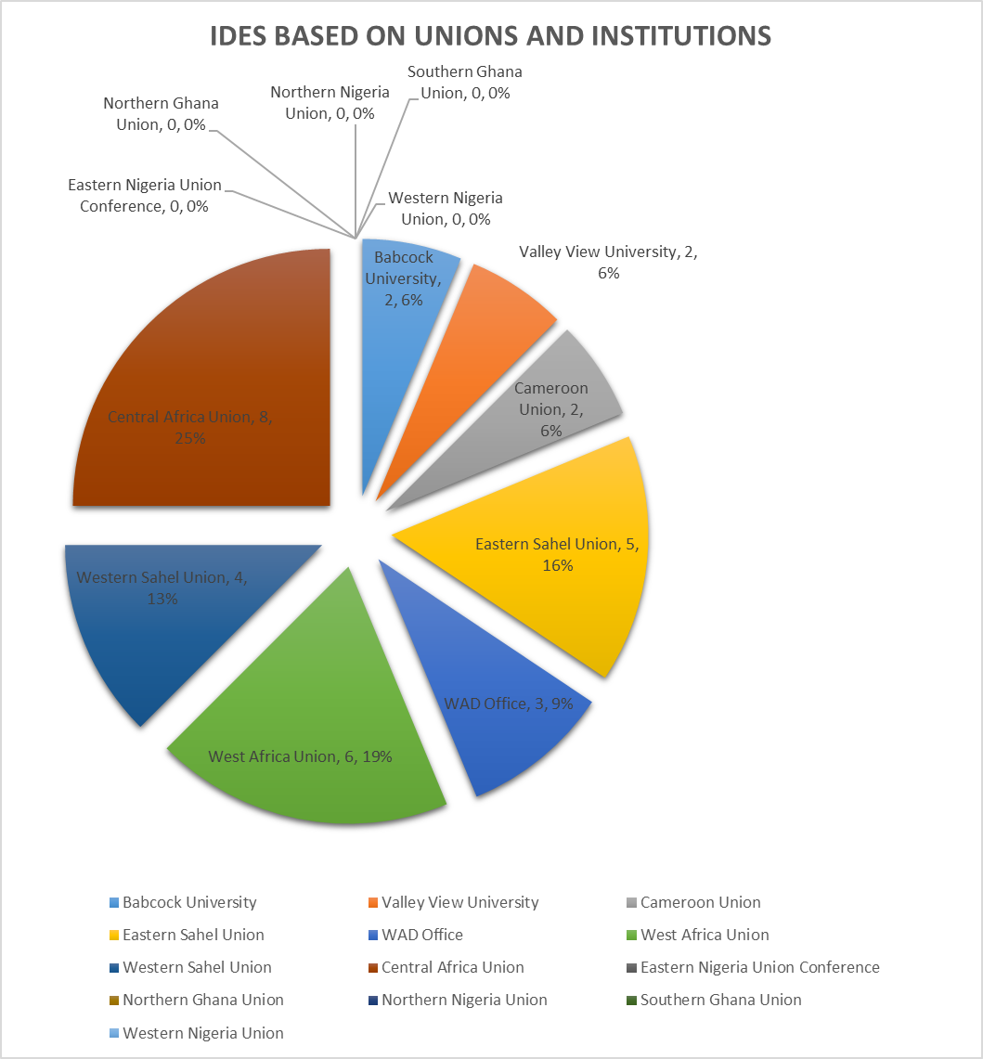

Slide 27
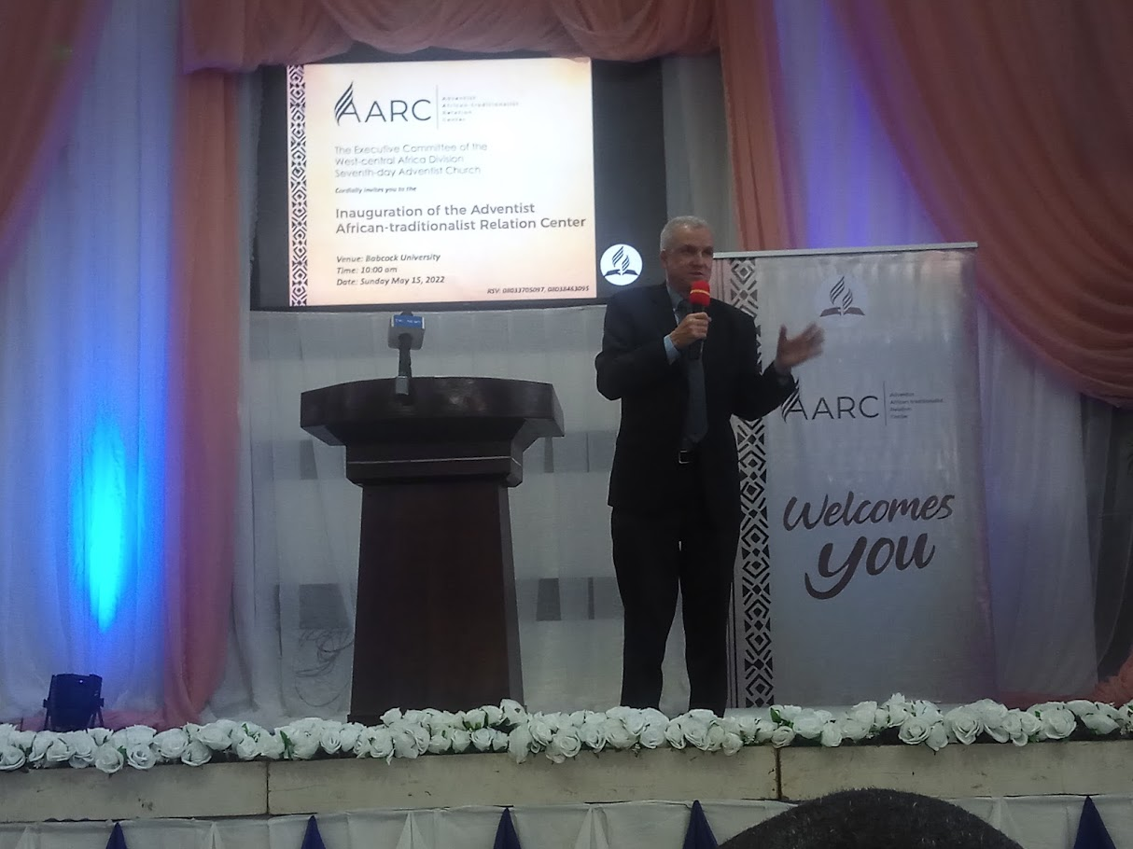
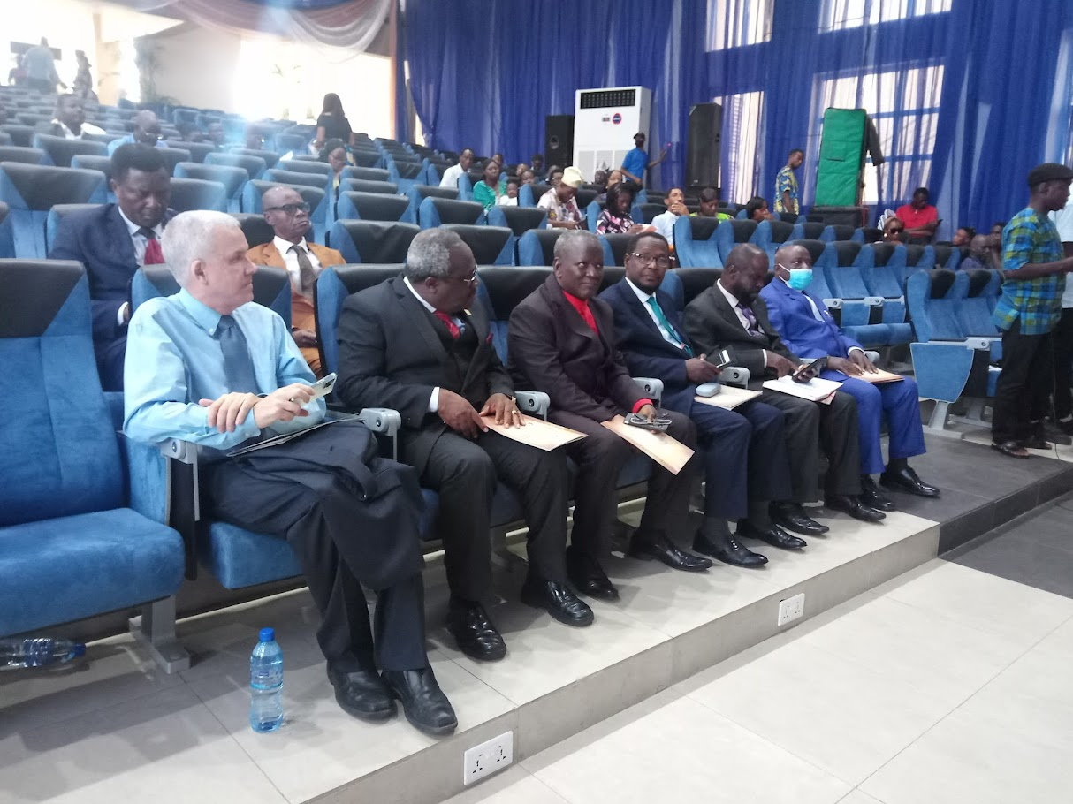

Slide 28
6 KEY STRATEGIC ISSUES OF THE SECRETARIAT STRATEGIC PLAN
OBJECTIF
5
To disciple individuals and families into spirit-filled lives.

Slide 29
6 KEY STRATEGIC ISSUES OF THE SECRETARIAT STRATEGIC PLAN
5.1.Significant increase in numbers of church members regularly praying, studying the Bible, using the Sabbath School Bible Study Guides, reading the writings of Ellen White and engaging in other personal devotions.
OBJECTIF
5

Slide 30
https://www.adventistresearch.info/wp-content/uploads/WAD-Church-Member-Research-Report-1.pdf

Slide 31
6 KEY STRATEGIC ISSUES OF THE SECRETARIAT STRATEGIC PLAN
OBJECTIF
5

Slide 32
7 KEY STRATEGIC ISSUES OF THE SECRETARIAT STRATEGIC PLAN
OBJECTIF
5

Slide 33
6 KEY STRATEGIC ISSUES OF THE SECRETARIAT STRATEGIC PLAN
OBJECTIF
5

Slide 34
Entity | RECORDED ATTENDANCE (Average)
 | Actual 3rd Qrtr 2022 | Sabbath School Attendance 3rd Qrtr 2022 | Church Attendance 3rd Qrtr 2022 | % of Sabbath School attendants compared to Membership | % of Divine Service attendants compared to Membership
Cameroon Union Mission | 125,589 | 68,695 | 76,331 | 55% | 61%
Central african Union Mission | 17,592 | 8,161 | 9,094 | 46% | 52%
Eastern Nigeria Union Conference | 177,892 | 130,291 | 129,606 | 73% | 73%
Eastern Sahel Union Mission | 31,014 | 28,068 | 29,928 | 90% | 96%
Northern Ghana Union Conference | 208,950 | 80,079 | 125,457 | 38% | 60%
Northern Nigeria Union Conference | 55,087 | 67,525 | 72,586 | 123% | 132%
Southern Ghana Union Conference | 190,230 | 83,761 | 101,749 | 44% | 53%
West African Union Mission | 47,680 | 23,109 | 23,828 | 48% | 50%
Western Nigeria Union Conference | 63,654 | 38,805 | 40,107 | 61% | 63%
Western Sahel Union Mission | 17,578 | 3,270 | 3,571 | 19% | 20%
WAD | 935,266 | 531,762 | 612,256 | 57% | 65%

Slide 35
6 KEY STRATEGIC ISSUES OF THE SECRETARIAT STRATEGIC PLAN
OBJECTIF
8
To strengthen the discipleship role of pastors, teachers, and other frontline workers and provide them with regular growth opportunities

Slide 36
6 KEY STRATEGIC ISSUES OF THE SECRETARIAT STRATEGIC PLAN
OBJECTIF
8
Increase the number of missionary care programs funded by WAD including more involvement of Division personnel;
Reestablish regular prayer sessions for ISEs in Secretariat/IPRS especially addressing their challenges as well as sending them personalized messages

Slide 37
6 KEY STRATEGIC ISSUES OF THE SECRETARIAT STRATEGIC PLAN
OBJECTIF
8
WAD ISE Coordinator regularly writes ISEs and call them to see to it that they are doing well.
Whenever a Secretariat Staff visits a field having an ISE, he or she endeavors to visit the missionary.

Slide 38
6 KEY STRATEGIC ISSUES OF THE SECRETARIAT STRATEGIC PLAN
OBJECTIF
8
Increase by 10 percent the re-employment of ISE/IUEs within six months of returning home who were previously denominationally employed
By God’s grace, all IUEs who disengaged with WAD after GC Session got employment within six months of returning home.

Slide 39
6 KEY STRATEGIC ISSUES OF THE SECRETARIAT STRATEGIC PLAN
OBJECTIF
9
To align world church resources with strategic objectives

Slide 40
6 KEY STRATEGIC ISSUES OF THE SECRETARIAT STRATEGIC PLAN
OBJECTIF
9
Every organization systematically reviews and aligns resources in light of the worldwide mission priorities

Slide 41
REFOCUSING ON MISSION

Slide 42
6 KEY STRATEGIC ISSUES OF THE SECRETARIAT STRATEGIC PLAN
OBJECTIF
10
To enhance the transparency, accountability, and credibility of denominational organization, operations, and mission initiatives

Slide 43
6 KEY STRATEGIC ISSUES OF THE SECRETARIAT STRATEGIC PLAN
OBJECTIF
10
Seventy-five percent of unions has officially adopted and started to implement approved membership software (ACMS).

Slide 47
62%

Slide 48
6 KEY STRATEGIC ISSUES OF THE SECRETARIAT STRATEGIC PLAN
OBJECTIF
10
An orientation process for officers and executive committee members of all units of denominational structure is developed and widely implemented

Slide 49
6 KEY STRATEGIC ISSUES OF THE SECRETARIAT STRATEGIC PLAN
OBJECTIF
10
WAD Secretariat conducted an orientation session for the new Executive Committee & WADCOM members (August 3-4, 2022)
Another orientation was conducted for all newly elected and appointed officers of the Division (August 1-4, 2022)

Slide 50
6 KEY STRATEGIC ISSUES OF THE SECRETARIAT STRATEGIC PLAN
OBJECTIF
10
Evidence that pastors and church leaders demonstrate the highest standards of integrity and ethical behavior in interpersonal relations and finances

Slide 51
6 KEY STRATEGIC ISSUES OF THE SECRETARIAT STRATEGIC PLAN
OBJECTIF
10
Keep providing WAD Working Policy books in English and French and studying the possibility of printing it also in Portuguese and Spanish.

Slide 52
6 KEY STRATEGIC ISSUES OF THE SECRETARIAT STRATEGIC PLAN
OBJECTIF
10
Training Church leaders on the importance of Policy Compliance.

Slide 53
FACTS ABTOUT WAD AS WE REFOCUS ON MISSION
WEST-CENTRAL AFRICA DIVISION
Organized 2003; reorganized 2013

Slide 54
FACTS ABTOUT WAD AS WE REFOCUS ON MISSION
Territory: Benin, Burkina Faso, Cabo Verde, Cameroon, Central African Republic, Chad, Congo, Cote d'Ivoire, Equatorial Guinea, Gabon, Gambia, Ghana, Guinea, Guinea-Bissau, Liberia, Mali, Mauritania, Niger, Nigeria, Senegal, Sierra Leone, and Togo (22 countries)

Slide 55
FACTS ABOUT WAD FOR ENHANCED MISSION
WAD: (5 Union Conferences, 5 Union Missions)
Statistics (June 30, 2022): Churches, 5,082; Companies: 5,427; membership, 935,266; population, 472,062,000 (online statistics).

Slide 56
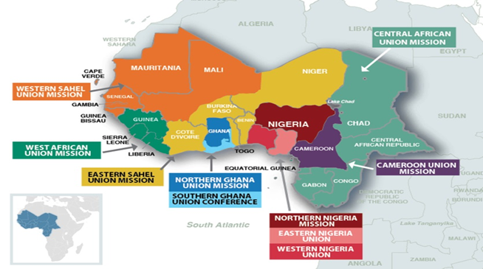
10 UNIONS
UNION CONFERENCE

Slide 57
West-Central Africa Division
When WAS THE UNION first organized?
CAMEROON UNION MISSION
(Formerly part of the Central African Union Mission)
Organized 1949; territory divided, and renamed 2013; reorganized 2018, 2020

Slide 58
West-Central Africa Division
When WAS THE UNION first organized?
CAMEROON UNION MISSION
Territory: Cameroon; comprising the Adamaoua-Mayo Rey, Central-South Cameroon, East Cameroon, Mbam-Sanaga, North Cameroon, Nyong-Afamba, and West Cameroon Conferences; and the Benoue-Faro Mission.
(7 Conferences, 1 Mission)

Slide 59
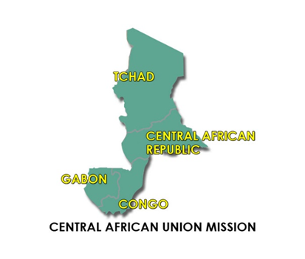
West-Central Africa Division
When WAS THE UNION first organized?
CENTRAL AFRICAN UNION MISSION
(The countries of this union as well as Cameroon previously made up the old Central African Union Mission. Cameroon became a separate union in 2013, and the remaining countries retained the name, Central African Union Mission.)
Organized 1949; reorganized, and territory divided 2013

Slide 60
West-Central Africa Division
When WAS THE UNION first organized?
CENTRAL AFRICAN UNION MISSION
Territory: Central African Republic, Chad, Congo, Equatorial Guinea, and Gabon; comprising the Central African Republic, Chad, Equatorial Guinea, and Gabon Missions; and the Congo Region. (4 Missions, 1 Region)

Slide 61
West-Central Africa Division
When WERE UNIONS first organized?
EASTERN NIGERIA UNION CONFERENCE
Organized 2004; reorganized 2013, 2015

Slide 62
West-Central Africa Division
When WERE UNIONS first organized?
EASTERN NIGERIA UNION CONFERENCE
Territory: The Nigerian states of Abia, Akwa Ibom, Anambra, Bayelsa, Cross River, Ebonyi, Enugu, Imo, and Rivers; comprising the Aba East, Aba North, Aba South, Abia North-Central, Akwa Ibom, Cross River, Ebonyi, Enugu, Imo, Port Harcourt, Rivers East, and Rivers West Conferences; and the Aba West, Anambra, Bayelsa, and Northern Cross River Missions.
(12 Conferences, 4 Missions)

Slide 63
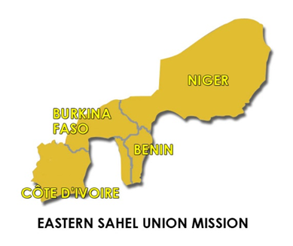
West-Central Africa Division
When WERE UNIONS first organized?
EASTERN SAHEL UNION MISSION
(Formerly known as the Sahel Union Mission)
Organized 1981; territory divided, and renamed 2013

Slide 64
West-Central Africa Division
When WERE UNIONS first organized?
EASTERN SAHEL UNION MISSION
Territory: Benin, Burkina Faso, Cote d'Ivoire, Niger, and Togo; comprising the Benin, Cote d'Ivoire, and Togo Conferences; Burkina Faso Mission; and Niger Region. (3 Conferences, 3 Missions, 1 Region)

Slide 65
West-Central Africa Division
When WERE UNIONS first organized?
NORTHERN GHANA UNION CONFERENCE
(Formerly part of Ghana Union Conference)
Organized 2013; reorganized 2015, 2021

Slide 66
West-Central Africa Division
When WERE UNIONS first organized?
NORTHERN GHANA UNION CONFERENCE
Territory: The northern portion of Ghana; comprising the Ashanti Central Ghana, Ashanti South Ghana, Central Ghana, Green View Ghana, Mid-Central Ghana, Mid-North Ghana, Mid-West Ghana, Mountain View Ghana, and South Central Ghana Conferences; and the North Ghana Mission. (9 Conferences, 1 Mission)

Slide 67
West-Central Africa Division
When WERE UNIONS first organized?
NORTHERN NIGERIA UNION CONFERENCE
(Formerly part of North-Western Nigeria Union Mission)
Organized 2013

Slide 68
West-Central Africa Division
When WERE UNIONS first organized?
NORTHERN NIGERIA UNION CONFERENCE
Territory: The Nigerian states of Adamawa, Bauchi, Benue, Borno, Gombe, Jigawa, Kaduna, Kano, Katsina, Kebbi, Nasarawa, Niger, Plateau, Sokoto, Taraba, Yobe, and Zamfara; and the Federal Capital Territory; comprising the North Central Nigeria, North East Nigeria, and North West Nigeria Conferences.
(3 Conferences)

Slide 69
West-Central Africa Division
When WERE UNIONS first organized?
SOUTHERN GHANA UNION CONFERENCE
(Formerly Ghana Union Conference)
Organized 2000; territory divided, and renamed 2013; reorganized 2017

Slide 70
West-Central Africa Division
When WERE UNIONS first organized?
SOUTHERN GHANA UNION CONFERENCE
Territory: The Central, Eastern, Greater Accra, Western, and Volta regions in southern Ghana; comprising the Accra City, Diamond Field Ghana, East Ghana, Eastern View Ghana, Meridian Ghana, Mid-South Ghana, Pioneer Ghana, South West Ghana, West-Central Ghana, and Western North Ghana Conferences; and the Volta Ghana, and Oti Ghana Missions.
(10 Conferences, 2 Missions)

Slide 71
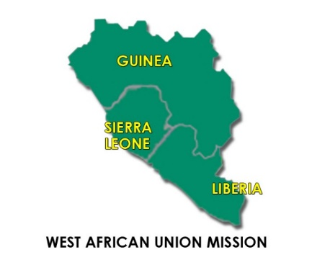
West-Central Africa Division
When WERE UNIONS first organized?
WEST AFRICAN UNION MISSION
Organized 1973, reorganized 2000, 2013
Territory: Guinea, Liberia, and Sierra Leone; comprising the South-West Liberia Conference; the Central Liberia, Sierra Leone, and South-East Liberia Missions; and the Guinea Region. (2 Conferences, 2 Missions, 1 Region)

Slide 72
West-Central Africa Division
When WERE UNIONS first organized?
WESTERN NIGERIA UNION CONFERENCE
(Formerly known as North-Western Nigeria Union Mission)
Organized 1972; reorganized 2004, 2013; territory divided, and renamed 2013

Slide 73
West-Central Africa Division
When WERE UNIONS first organized?
WESTERN NIGERIA UNION CONFERENCE
Territory: The Nigerian states of Delta, Edo, Ekiti, Kogi, Kwara, Lagos, Ogun, Ondo, Osun, and Oyo; comprising the Delta, Edo, Ekiti, Kwara, Lagos Atlantic, Lagos Mainland, Ogun, Osun, and Oyo Conferences; the Ondo Mission; and the Kogi Region.
(9 Conferences, 1 Mission, 1 Region)

Slide 74
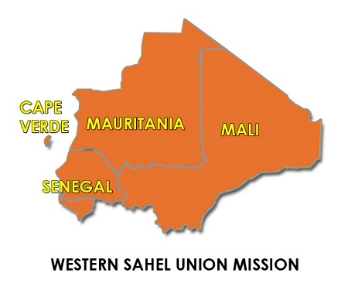
West-Central Africa Division
When WERE UNIONS first organized?
WESTERN SAHEL UNION MISSION
(Formerly part of Sahel Union Mission)
Organized 2013
Territory: Cabo Verde, Gambia, Guinea-Bissau, Mali, Mauritania, and Senegal; comprising the Cabo Verde Conference; the Guinea-Bissau, Mali, and Senegal/Mauritania Missions; and the Gambia Region.
(1 Conference, 3 Missions, 1 Region)

Slide 75
West-Central Africa Division
Unions by number of CONFERENCES

Slide 76
West-Central Africa Division
Unions by population

Slide 77
West-Central Africa Division
Unions by membership

Slide 78
West-Central Africa Division
Unions by number of churches

Slide 79
West-Central Africa Division
Unions by number of COMPANIES

Slide 80
West-Central Africa Division

Slide 81
West-Central Africa Division

Slide 82
West-Central Africa Division

Slide 83
AS WE ARE REFOCING ON MISSION IT IS IMPORTANT FOR USE TO KNOW THAT WE ARE ALSO LOSING MEMBERS

Slide 84
DEATHS

Slide 85
DROPPED

Slide 86
MISSING

Slide 87
ADJUSTMENTS

Slide 88
TOTAL LOSSES

Slide 89
West-Central Africa Division
Unions by number of ministerial credential

Slide 90
West-Central Africa Division
Unions by number of TOTAL ACTIVE EMPLOYEES

Slide 91
West-Central Africa Division
Unions by number of LITERATURE EVANGELISTS

Slide 92
TITHE CONTRIBUTIONS BY REGIONS
West-Central Africa Division
 | 2019 | 2020
French/Portuguese/Spanish countries (17 countries) | 20% | 22%
Ghana | 52% | 52%
Nigeria | 26% | 24%
WAUM (3 countries) | 2% | 2%

Slide 93
TITHES DEMOGRAPHICS

Slide 94
OFFERING CONTRIBUTIONS BY REGIONS
 | 2019 | 2020
French/Portuguese/Spanish countries (17 countries) | 14% | 16%
Ghana | 63% | 60%
Nigeria | 22% | 23%
WAUM (3 countries) | 1% | 1%

Slide 95
GROSS OFFERING DEMOGRAPHICS

Slide 96
PRIORITIES OF THE WORLD CHURCH FOR WAD AS WE REFOCUS ON MISSION

Slide 97
WAD PRIORITY PEOPLE GROUP
Priority Rank | National Languages | Speakers | Location
1 | French | 55,274,710 | Entire Region
2 | Arabic | 6,225,600 | Entire Region
Indegenous Languages
1 | Hausa | 50,679,100 | Widely Spoken
2 | Bamananka | 14,181,800 | Cote d’Ivoire, Senegal, Gambia, Mali, Mauritania, Niger
3 | Adamawa Fulfulde | 13,061,000 | Cameroon, Nigeria, Chad
4 | Moore | 13,388,000 | Burkina Faso, Mali
5 | Wolof | 12,227,300 | Mauritania, Senegal
6 | Central Kanuri | 8,477,500 | Cameroon, Niger, Nigeria, Chad

Slide 98
STRATEGIC PLAN FOCUS
2022-2025

Slide 99
REFOCUSING ON MISSION

Slide 100
This vision will be achieved through souls winning, disciples making, trainings, secretariat evaluation and re-evaluation, redemptive membership audit, nurture and retention activities, and enforment of policy compliance at all levels.

Slide 101
“A revival and reformation must take place under the ministration of the Holy Spirit. Revival and reformation are two different things…
(1 SM, page 128)

Slide 102
“… Revival signifies a renewal of spiritual life, a quickening of the powers of mind and heart, a resurrection from spiritual death. Reformation signifies a reorganization, a change in ideas and theories, habits and practices.”
(1 SM, page 128)

Slide 104
My appreciation goes to:
Pastor Robert Osei-Bonsu, President
The Treasurer, Elder Markus Musa Dangana and his team.
The Departmental Directors and their Associates
The Unions and Institutions Officers
My Predecessor: Pastor Kingsley Anonaba and other Secretariat former Team Members: Sister Love Drah and Gnamba Jonas.
WAD Associate Secretaries: Elder Frederick O. Falayi; Pastor Nathan T. Odonkor,
WAD Executive Committees Members

Slide 105
My dear family and all those who pray for me
WAD Administrative Secretaries: Rene Kamonou & Monica Louise Bakari.
WAD Translator: David Kiminou.
WAD Receptionist: Mrs. Emah Same.
GOD Almighty

